Slide 1
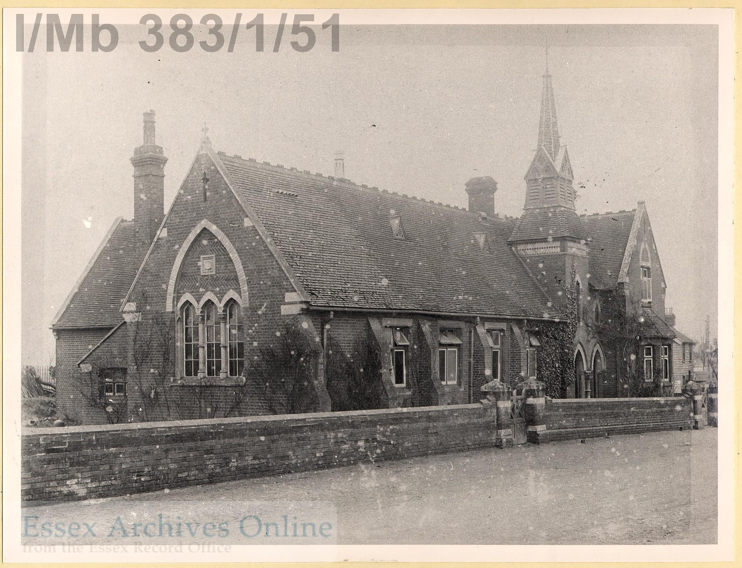
Primary Sources for the Classroom
Victorian photographs
Check the notes section for additional information and lesson ideas.
Notes:
Check the notes section for additional information and lesson ideas.

Slide 2
Notes:
Outside a Victorian school – photograph taken around 1900.

Slide 3
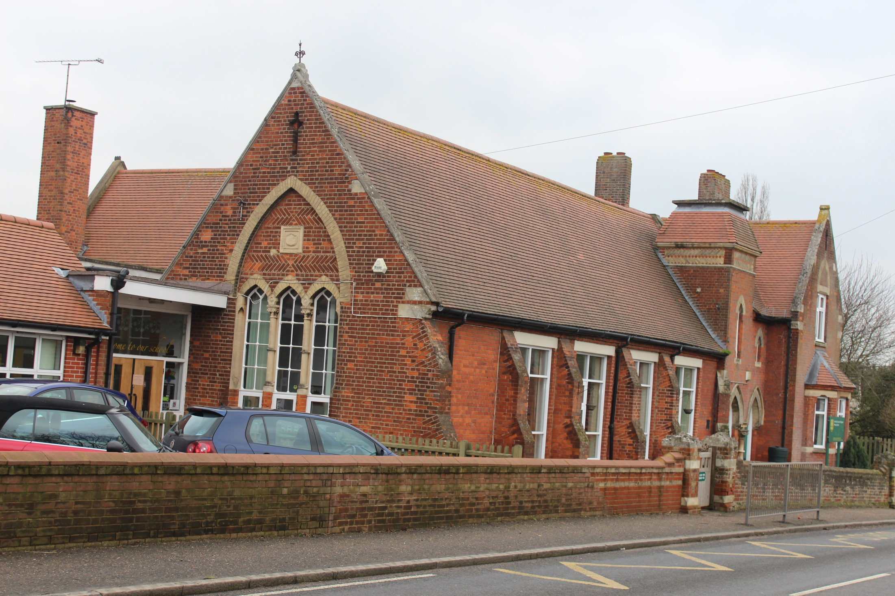
Notes:
Outside a Victorian school – photograph taken 2017.

Slide 4
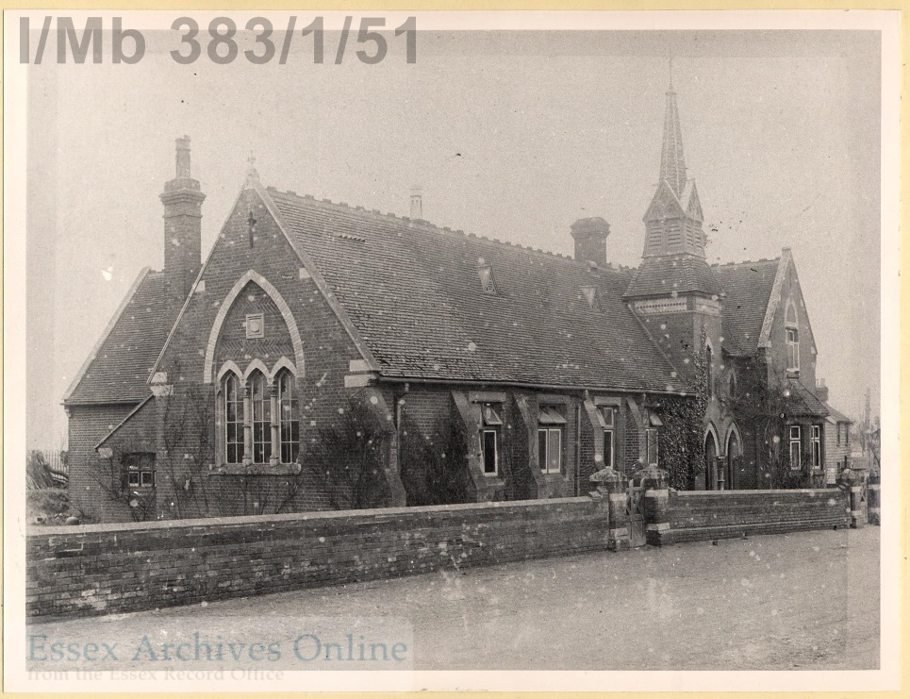
Notes:
What has stayed the same? The shape of the windows / the main building / the wall and gate / the fact that it is still a school.
What is different? The turret seems to have fallen down / it’s bigger – extensions added / there are cars

Slide 5
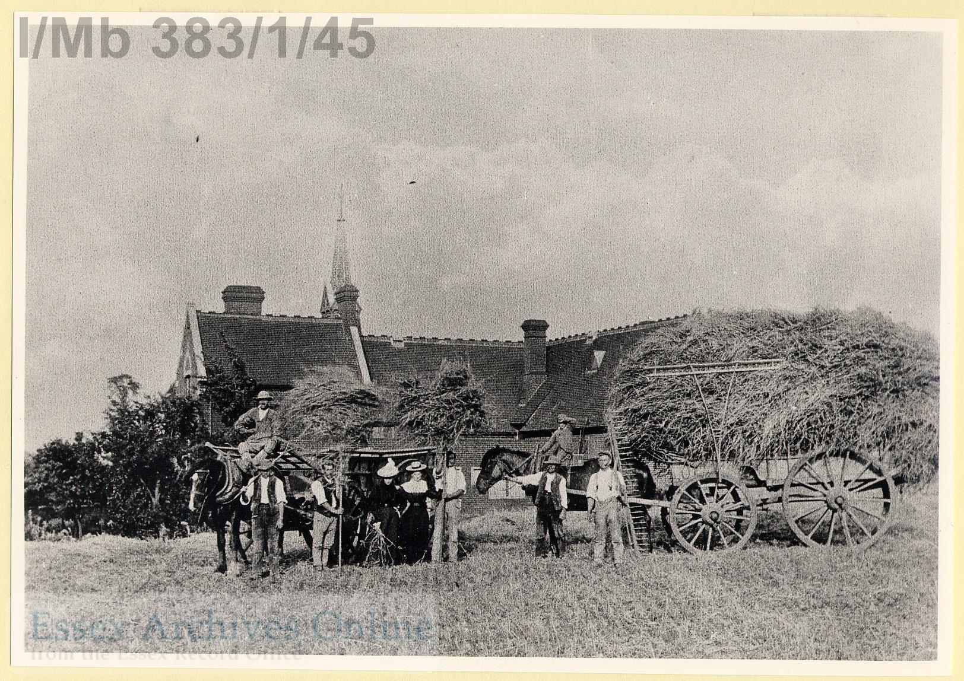
Notes:
Harvesters at work in Smith Field (school in the background). Photograph from around 1900.

Slide 6
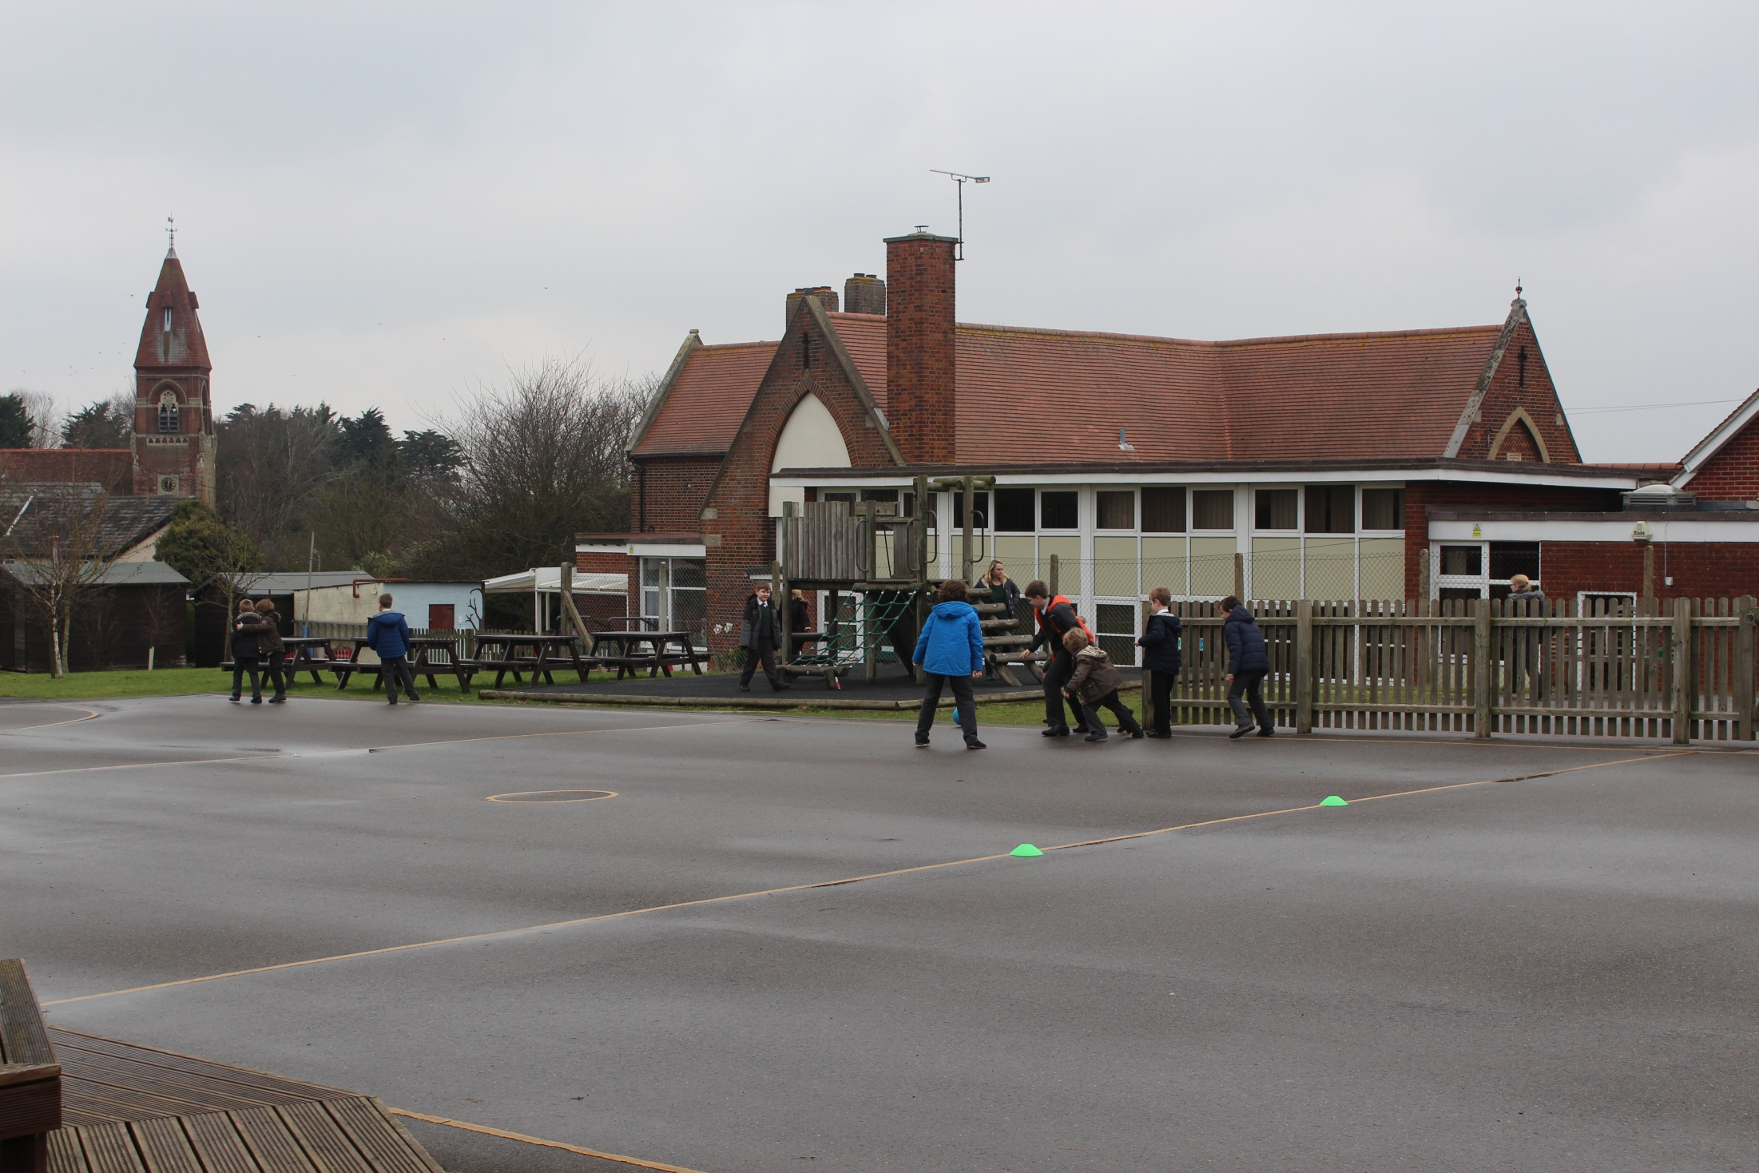
Notes:
School extended and concrete playground laid. Photograph 2017.

Slide 7
Notes:
What has stayed the same? School is still in the same place.
What is different? Use of horses / people’s clothes / Farm turned into playground

Slide 8
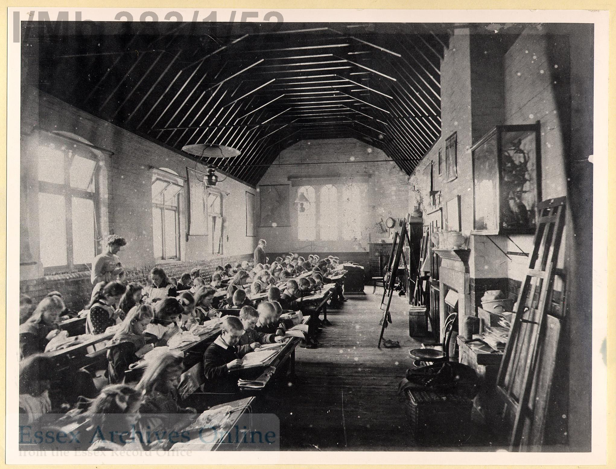
Notes:
Inside the school. Photograph from around 1900.

Slide 9
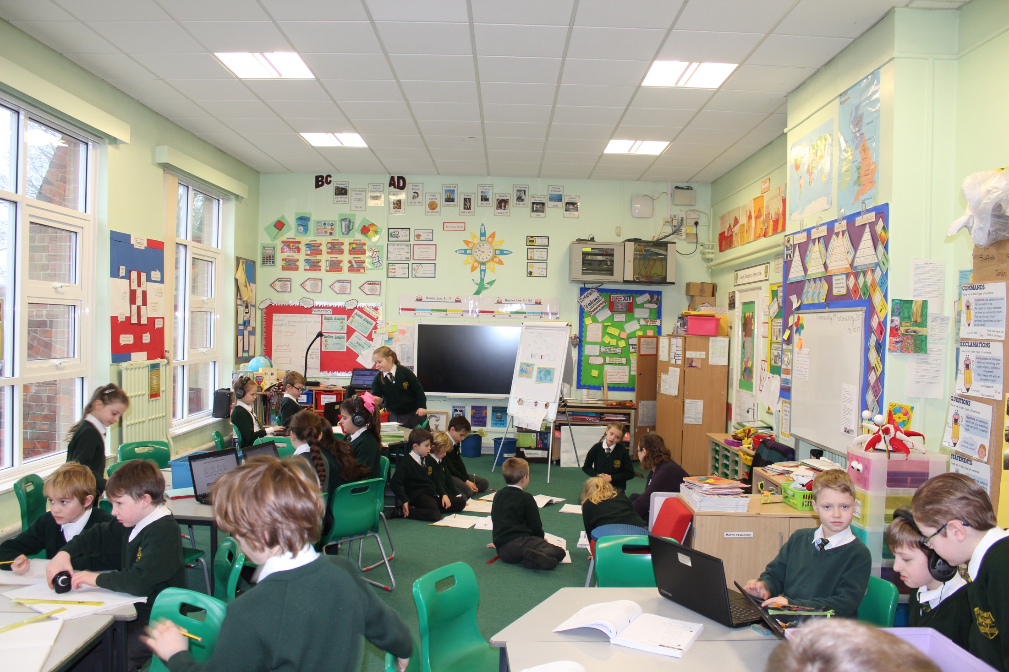
Notes:
Inside the school. Photograph taken 2017.

Slide 10
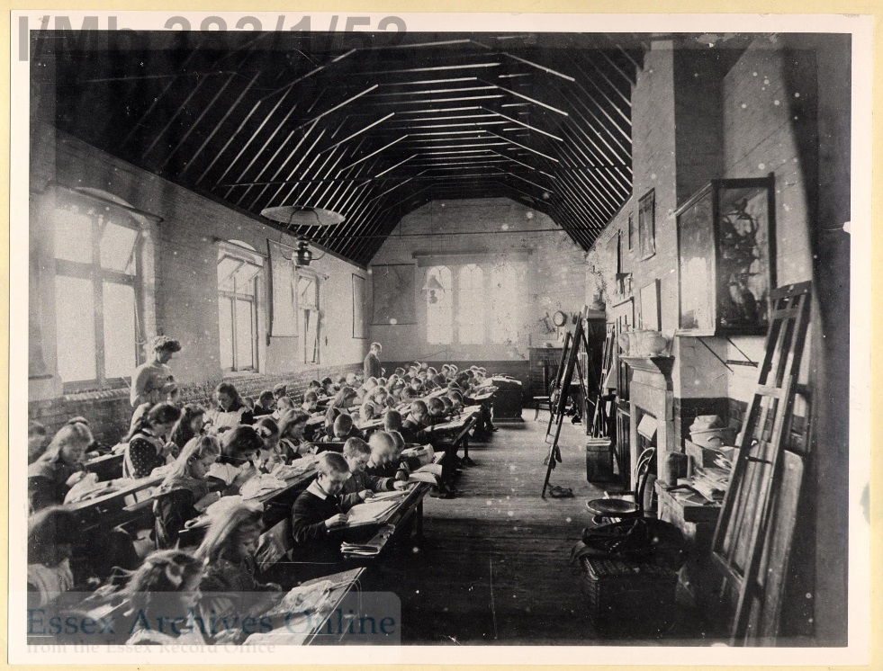
Notes:
What has stayed the same? Believe it or not – this is the same classroom! It is now divided into three rooms, but the windows and chimney are in the same place.
What is different? The lessons: 1900 – girls are sewing & boys are writing. 2017 – there are computers and smart boards. The desks, the work on the walls, the number of children, the uniforms, the types of lessons, the lighting (gas lights to electric lights) and heating (fireplace to radiators).

Slide 11
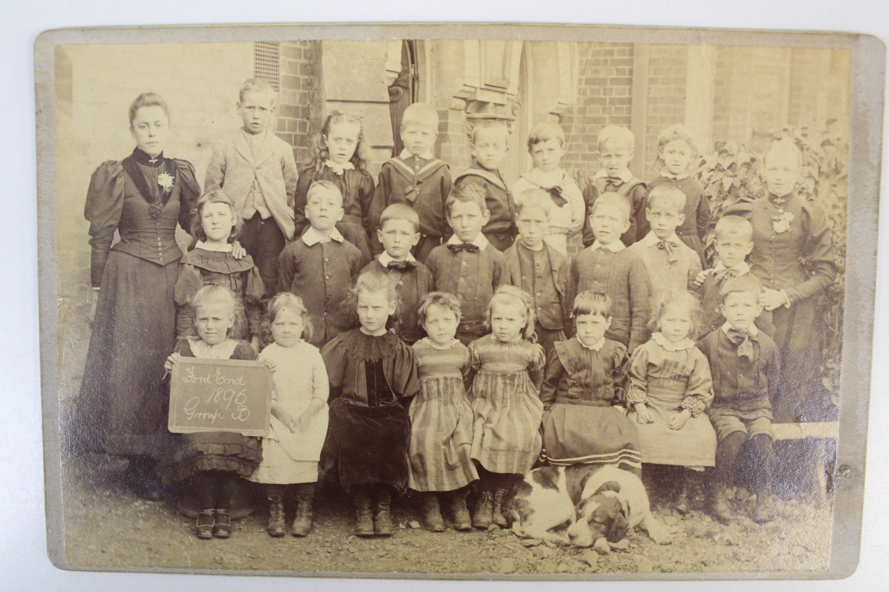
Notes:
Children from the school – photograph from around 1900.
How does this compare to your school photographs?

Slide 12
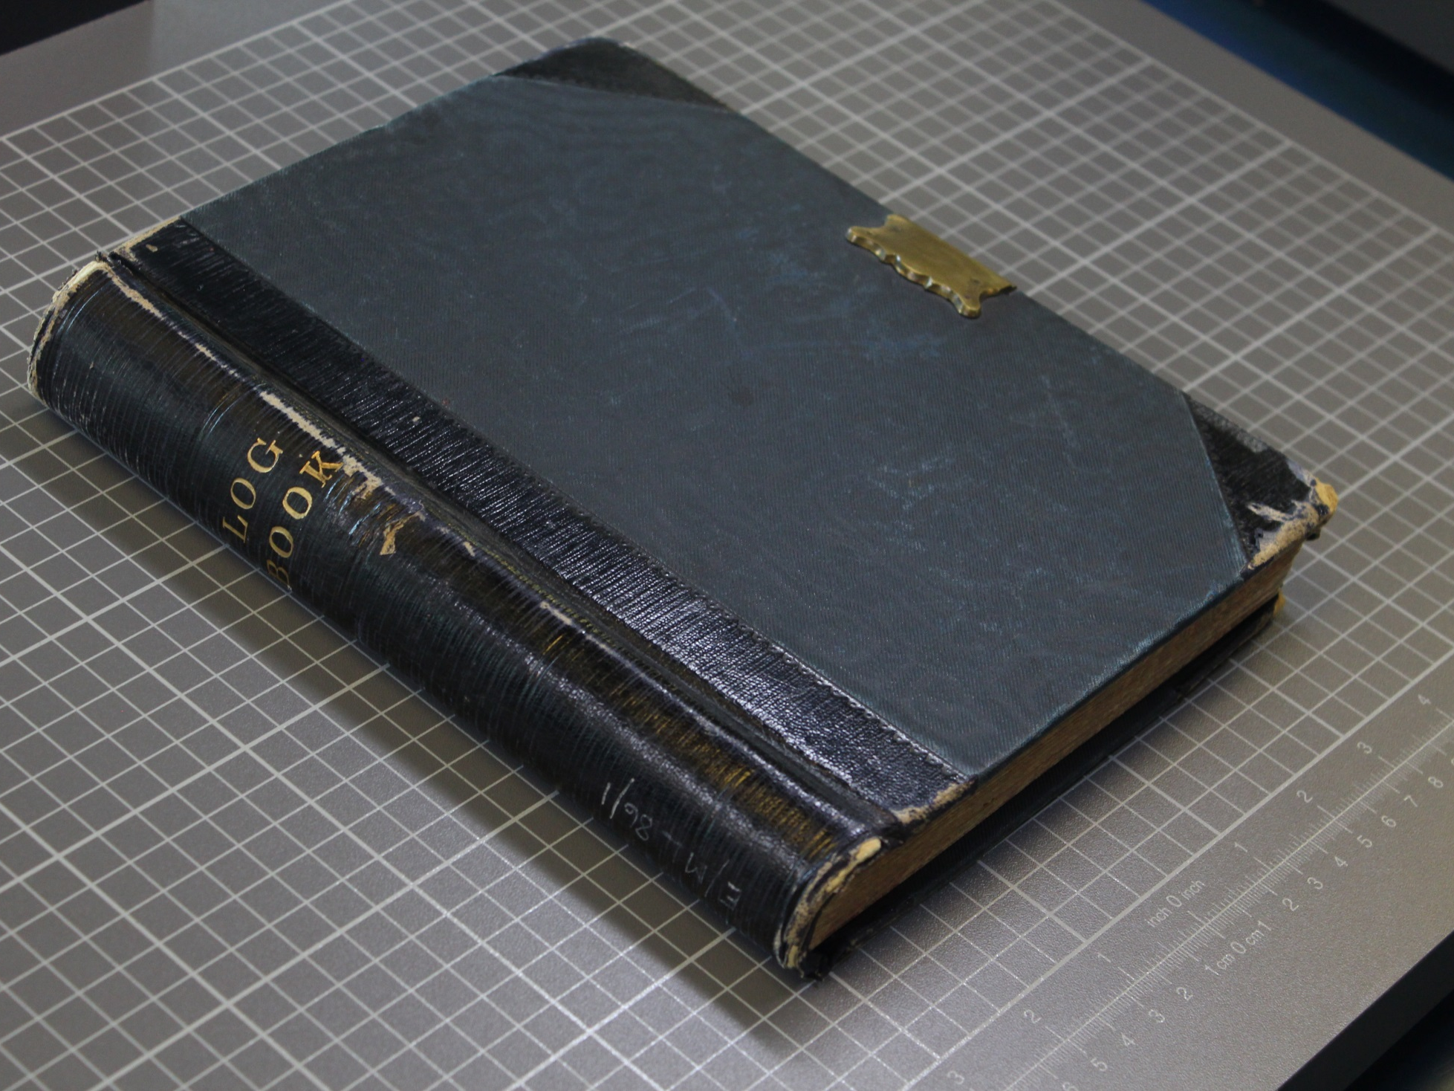
Was this useful to you?
Help us shape our content and share good ideas for other teachers.
E-mail Valina at:
heritage.education@essex.gov.uk
Notes:
Was this useful to you?
Help us shape our content and share good ideas for other teachers.
E-mail Valina at:
heritage.education@essex.gov.uk

