Slide 1
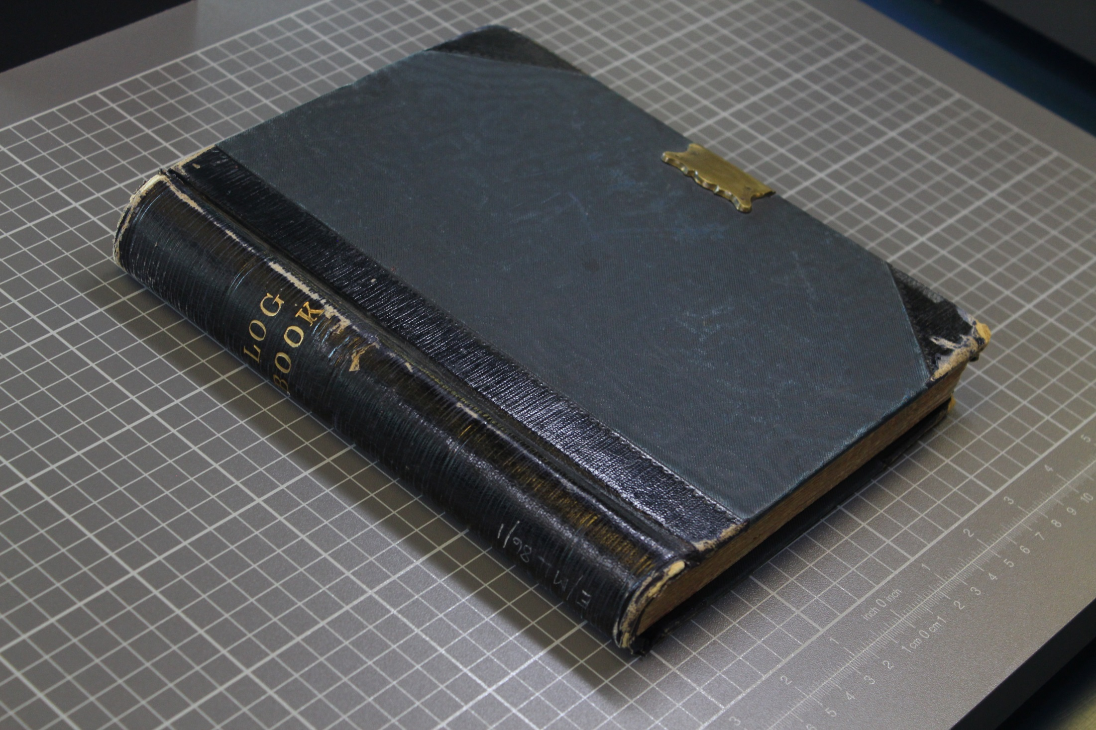
Primary Sources for the Classroom
Victorian Log Book
Notes:
Check the notes section for additional information and lesson ideas.
A school log book is like a journal, usually kept by the Head Teacher, which includes daily life at the school. This one was started in 1894 when the school opened.

Slide 2
Notes:
What’s in this book? Is it old or new? Do you notice the lock? What do the words on the spine say?
Essex Archives Online. Catalogue reference: E/ML 86/1

Slide 3
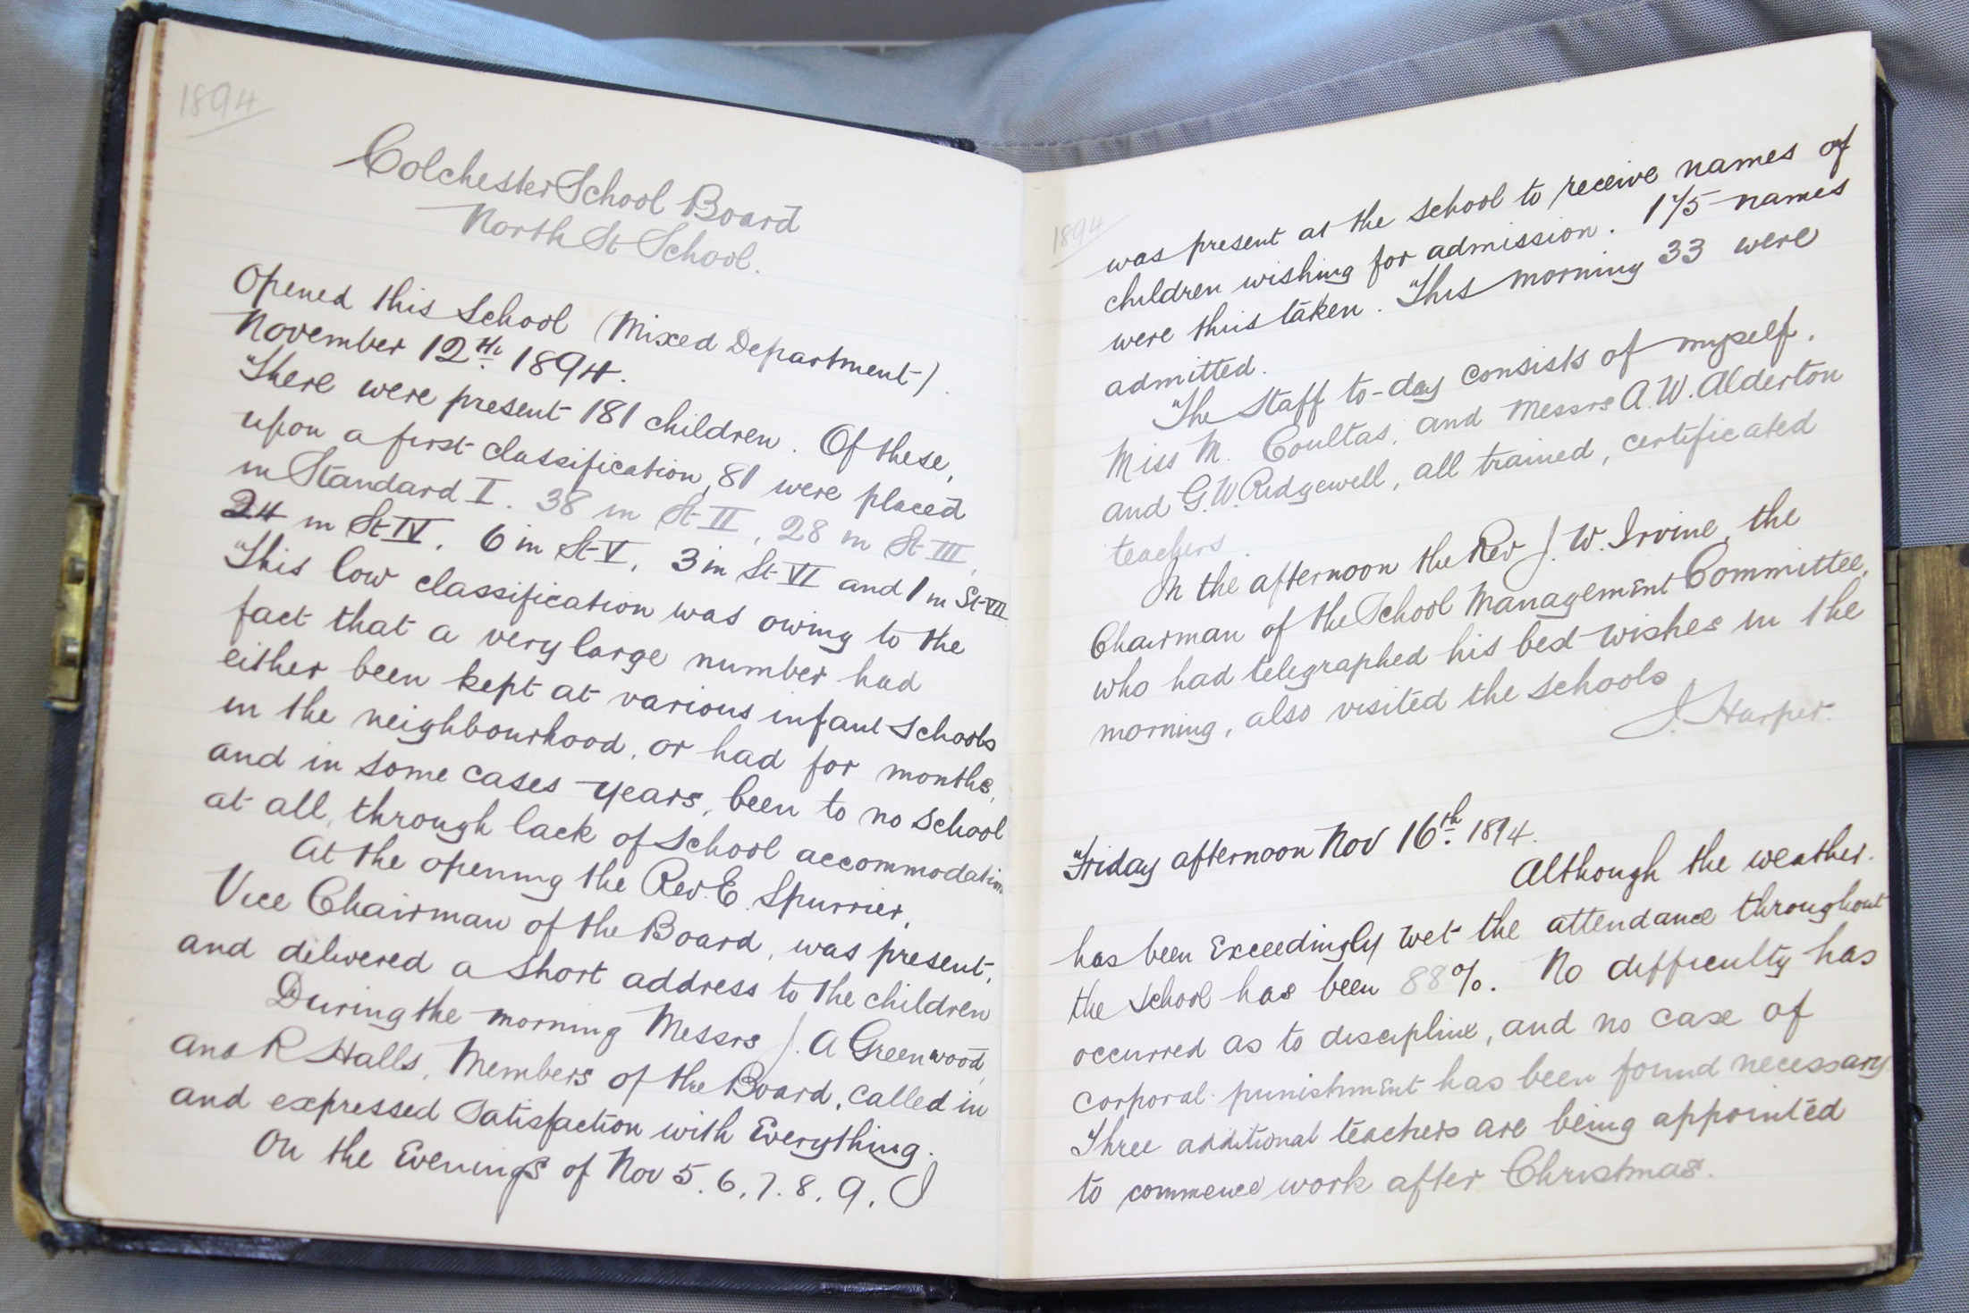
Notes:
Here is the book open. Now what clues do we have?
We can see dates. It is from 1894 – it is Victorian.
Says ‘school’ at the top.
It’s hand written – does it look like writing by a child or adult? (Explore this more on slide 5).

Slide 4
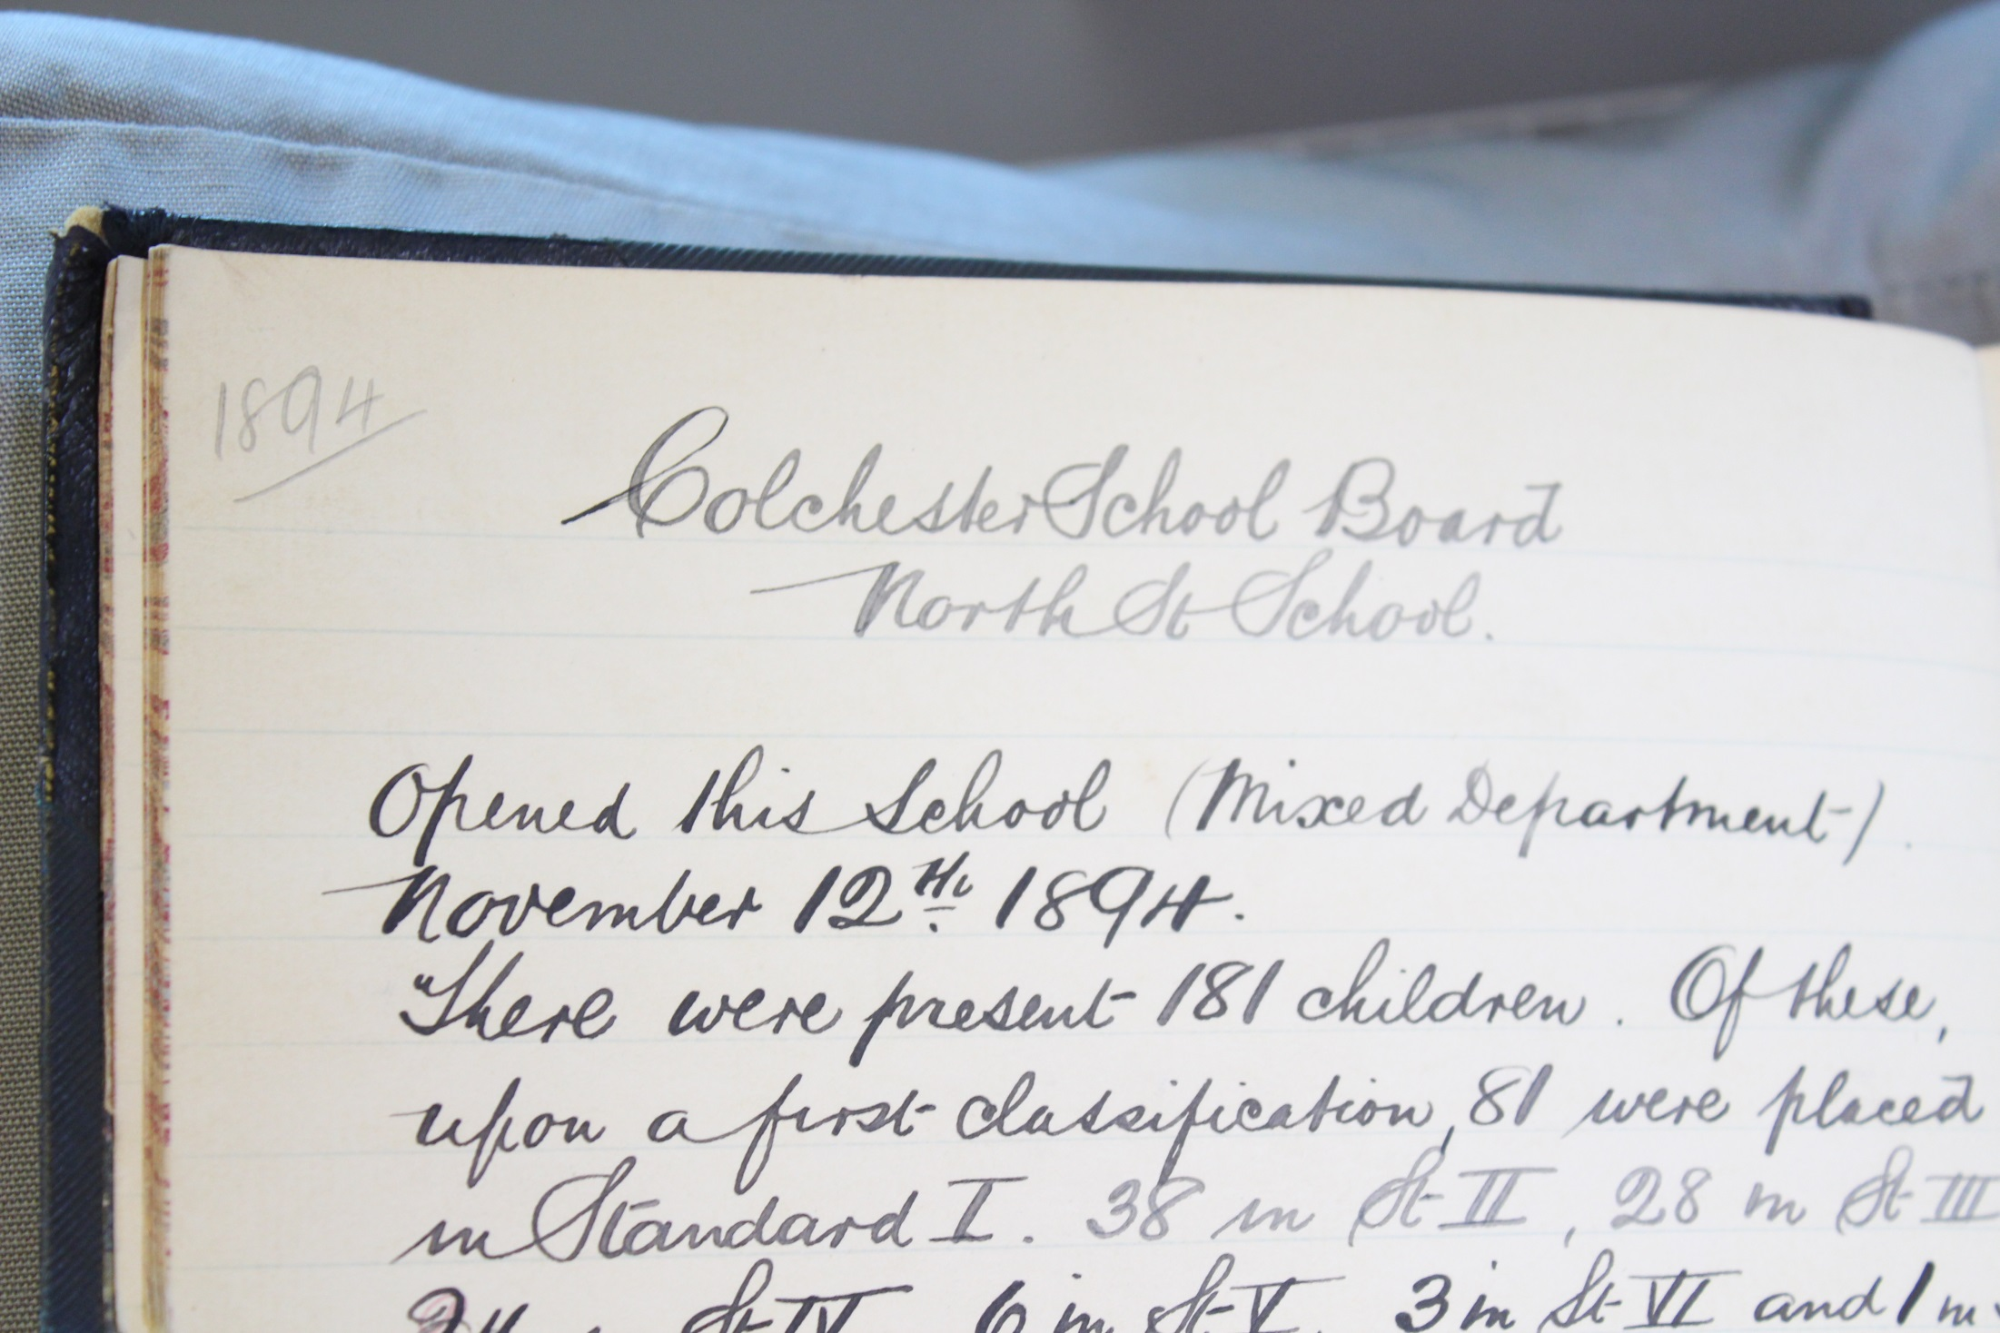
Notes:
Looking closely at the front page. This log book is for North St (Street) School.
When was it opened? November 12th 1894.
What does ‘Mixed Department’ mean? Boys and Girls can go.
How many children came? 181 children.
How many children go to your school today? More or less?

Slide 5
Notes:
The signature reads: J. Harper.
Who could he be? Adult? Child? Teacher? Head teacher?
John Harper was the first Head Teacher at North School. What do you think he was like? Strict? Frightening? Did he use the cane?

Slide 6
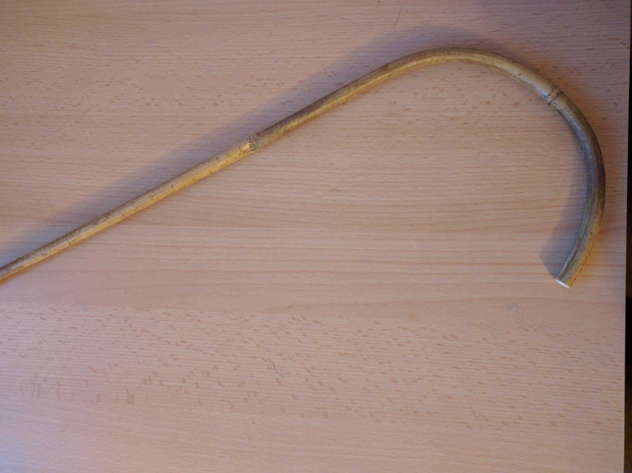
Discipline
Notes:
What was discipline like?

Slide 7
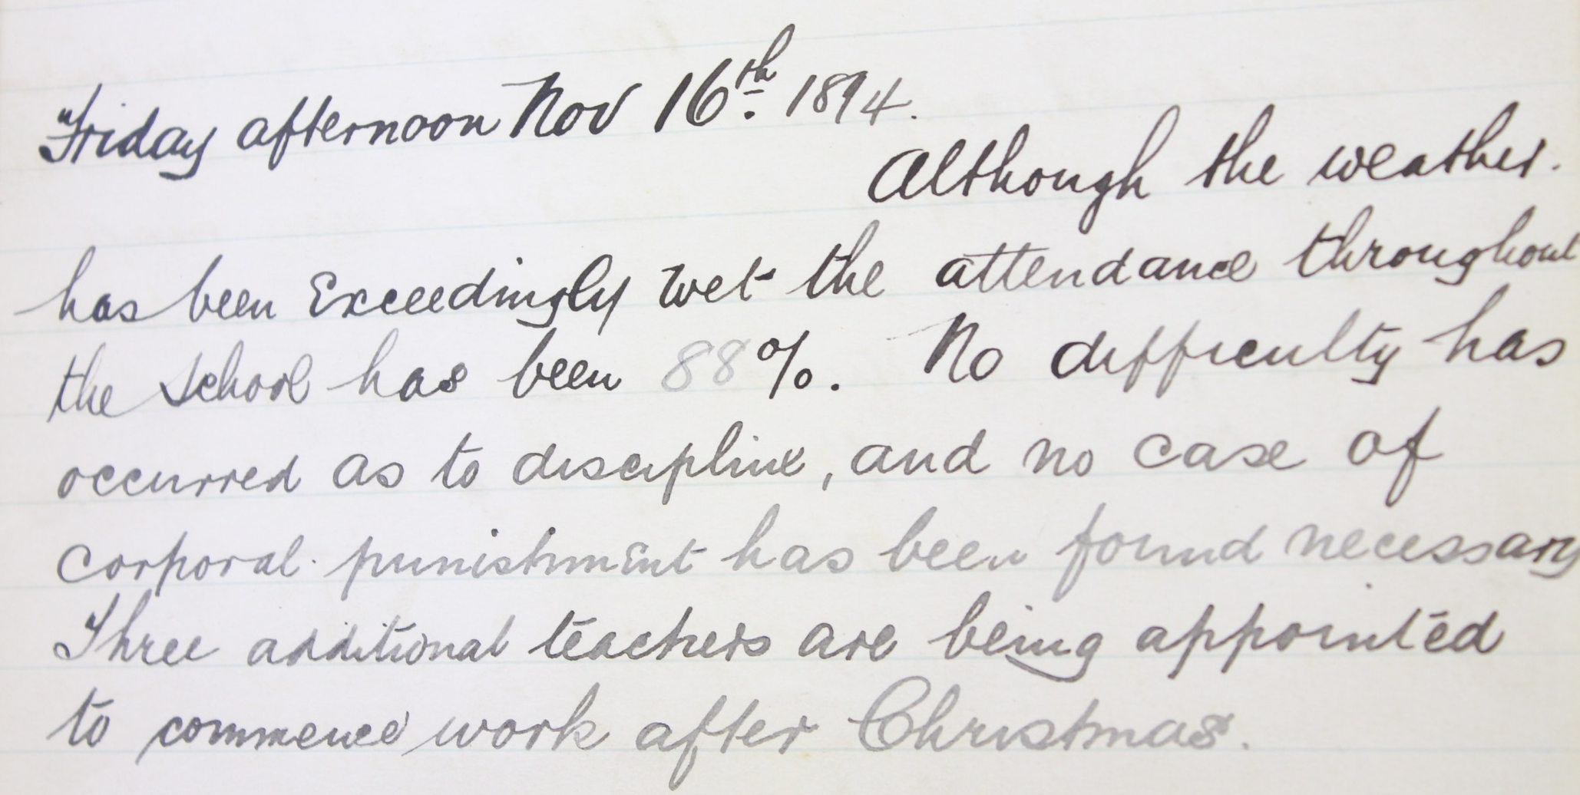
No difficulty has
occurred as to discipline, and no case of corporal punishment has been found necessary
Notes:
Four days after the school has opened it says:
“No difficulty has occurred as to discipline, and no case of corporal punishment has been found necessary”
Did you expect this?

Slide 8
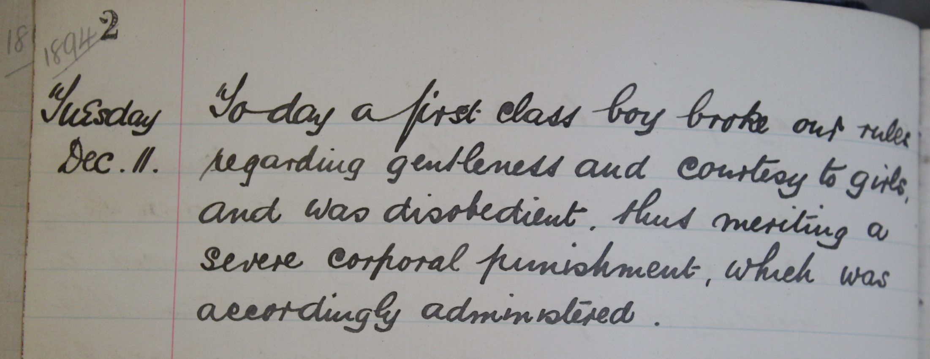
1894
Tuesday
Dec. 11.
Today a first class boy broke our rules regarding gentleness and courtesy to girls,
and was disobedient, thus meriting a
severe corporal punishment, which was
accordingly administered.
Notes:
On 11th December a boy from the first class was caned. Why?

Slide 9
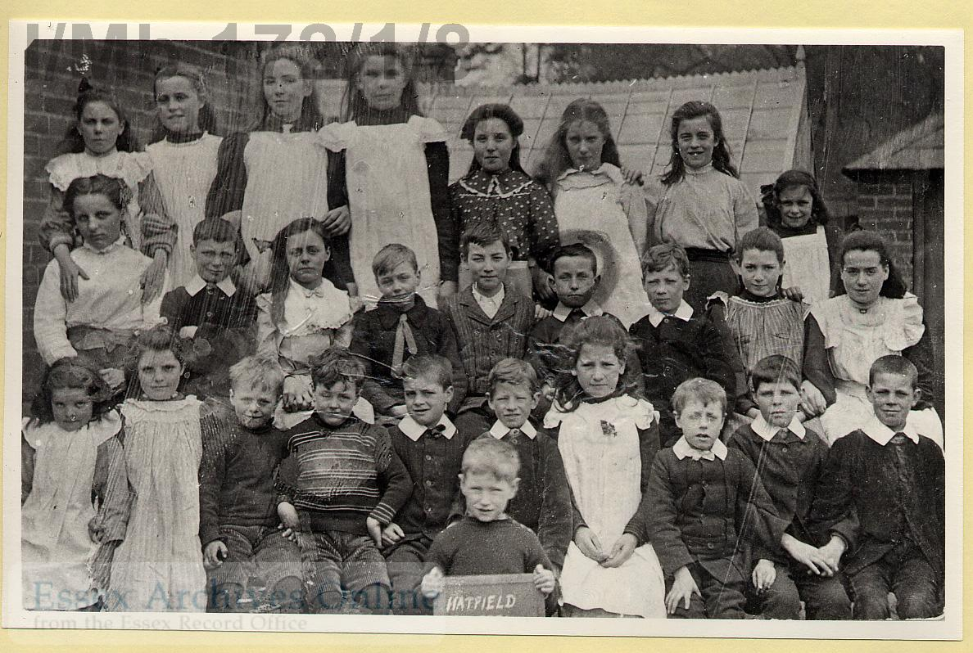
The children
Notes:
What did the teacher think about the children?

Slide 10
… and the discipline seems to me
Everything that can be desired. The general
intelligence of the class although improving
is not yet what we should like to see.
Notes:
The Head teacher thinks that discipline is good, but would like it if the children were more intelligent. Many cannot read or write.

Slide 11
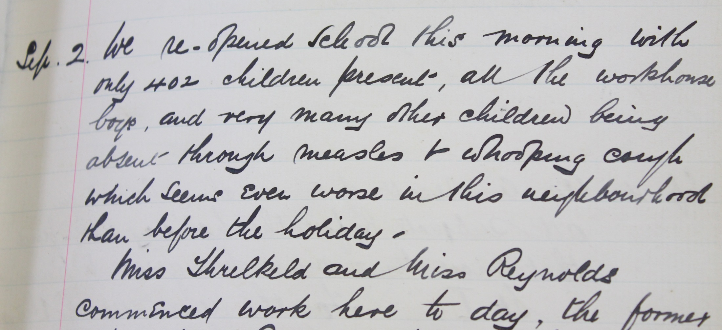
We re-opened school this morning with
only 402 children present, all the workhouse (poor) boys, and very many other children being
absent through measles & whooping cough
which seems even worse in this neighbourhood
than before the holiday.
Notes:
He is worried about low attendance due to serious illnesses like measles and whooping cough. School was free, but many of these children could not afford to go to the doctor or afford medicine.
Notice the number of children in the school has increased from 181 when it first opened to over 400 nearly a year later.

Slide 12
A circus is pitched to day
in a field adjoining, open for children
only this afternoon. Although we have
made every effort to prevent this, our
attendance has suffered, 444 only being
present compared with 473 this morning.
Notes:
He doesn’t want the children to miss school and go to the circus.

Slide 13
The Work house Children
Notes:
Poor people who were unable to find jobs might find themselves homeless or unable to buy food to eat. If they had no other choice they would have to go to the workhouse. This offered food and shelter, but also meant families were split up and had to do difficult or pointless work activities.

Slide 14
1894
Friday afternoon Nov 23rd
According to arrangement
45 children from the Colchester Workhouse
were admitted to the school.
Notes:
Work house children were supposed to go to school. There was a work house only 10 minutes walk from North School.
November: How many children does the Head Teacher agree to take?
He waits for them to turn up.

Slide 15
A communication has been received from the master of the workhouse stating that as such a large proportion of the children are ill, the doctor has advised that all be kept at home till after Xmas. At my request, seeing that this would seriously affect the average attendance, this arrangement has been modified by detaining only the worst cases.
Notes:
December: nearly a month later.
Have the work house children been allowed to go to school? No
Why not? Supposedly many are ill and all are being kept in (home for them is the workhouse)
The head teacher doesn’t believe that they are all ill and asks that some be allowed out.
What could be happening?
They could really be ill
The master is afraid that they will run away if he lets them out
The master earns money from work the children do. He wants them to do work and not go to school.

Slide 16
The absence of the workhouse children and
the bad weather has kept the average
attendance low this week.
Notes:
January 1895. Still no work house children (all of them have been stopped attending school now)

Slide 17
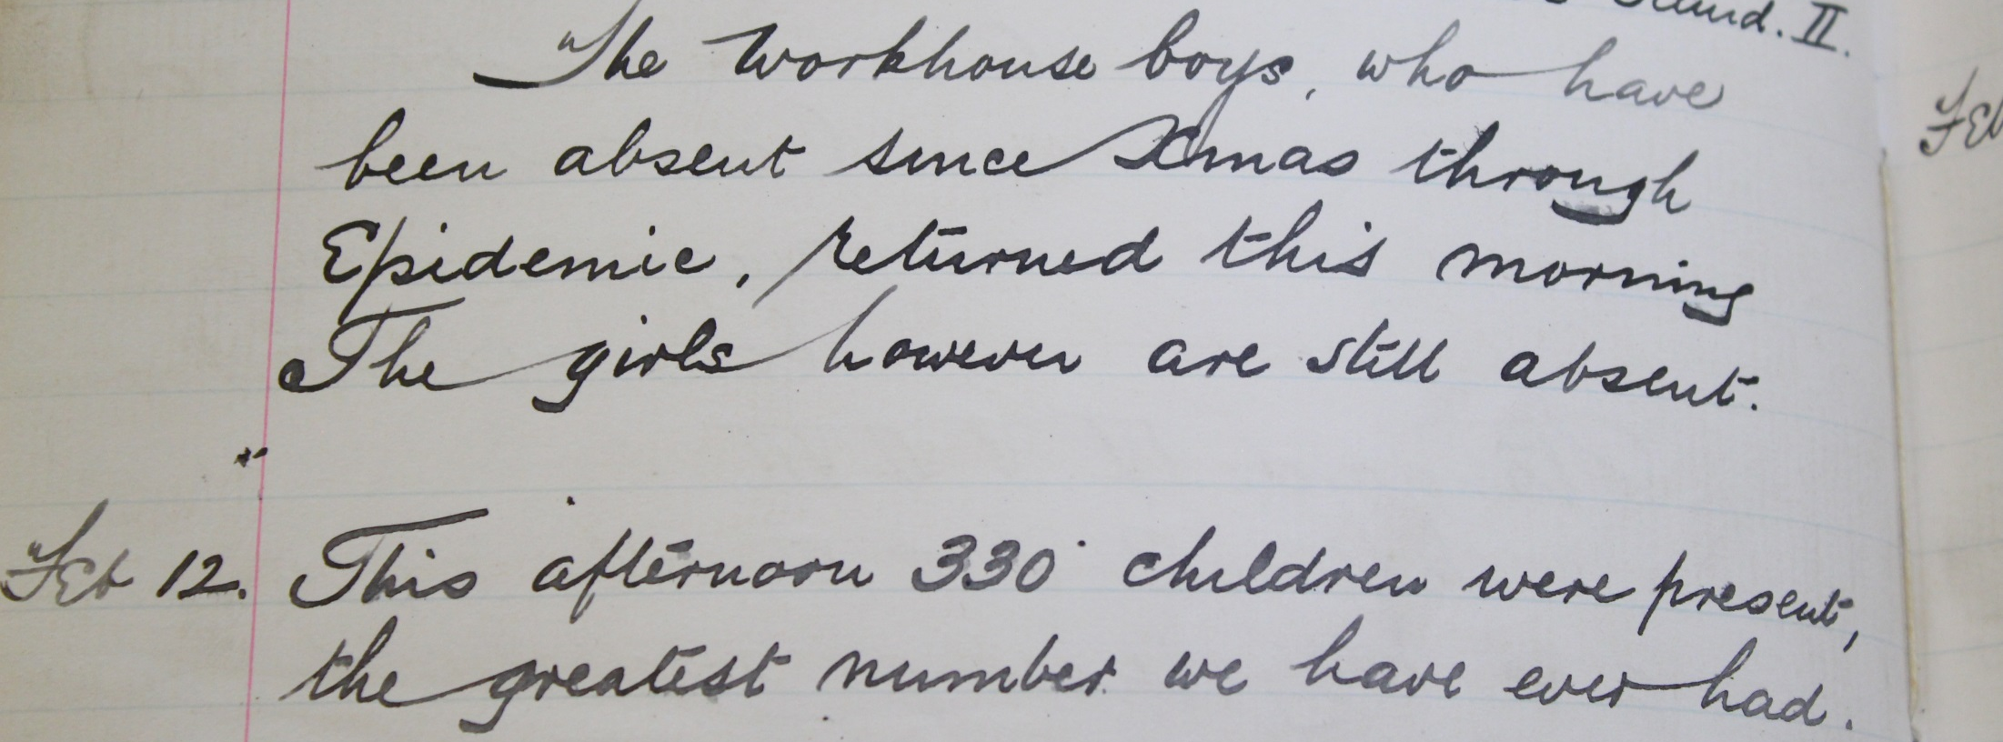
The workhouse boys, who have
been absent since xmas through
Epidemic, returned this morning
The girls however are still absent.
This afternoon 330 children were present,
the greatest number we have ever had.
Notes:
February: Boys from the workhouse are FINALLY allowed to go to school.

Slide 18
This morning the Workhouse girls returned.
Notes:
March: Girls from the work house are allowed to go to school.
Do you think the children know how to read and write?
Will they be able to learn if they keep missing school?
What will happen when they try and get a job?
Is this fair?

Slide 19
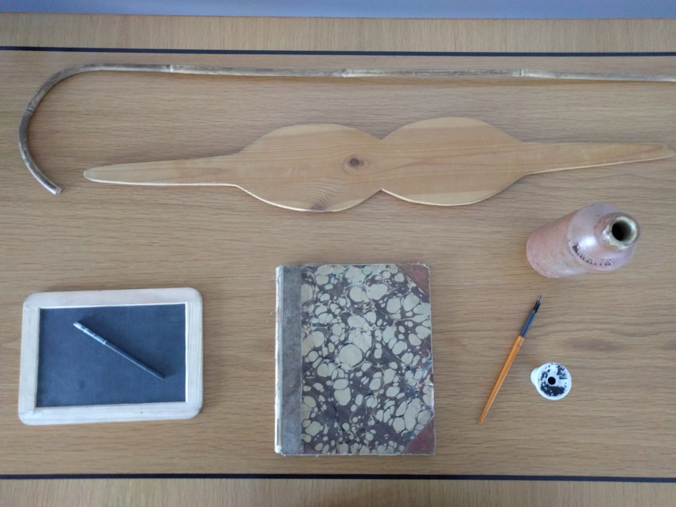
The Teachers
Notes:
What was life like for the teachers? Was it the same for men and women?

Slide 20
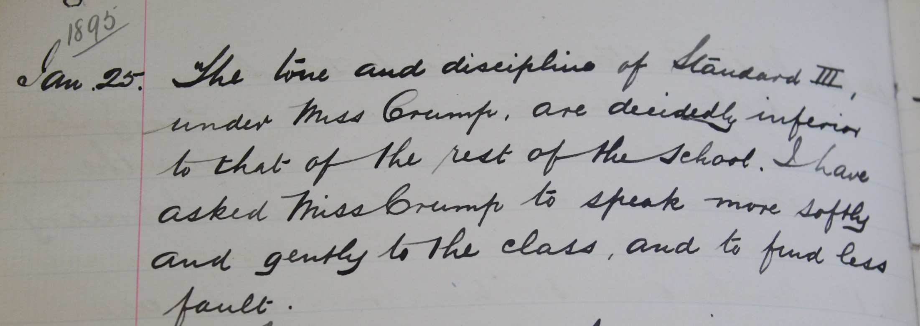
The tone and discipline of Standard III (class 3)
under Miss Crump, are decidedly inferior
to that of the rest of the school. I have
asked Miss Crump to speak more softly
and gently to the class, and to find less fault
Notes:
The Victorians had some strange ideas about what women could and could not do. Miss Crump needs to be more lady-like and is asked to speak softly and gently to them.
They sound like a lively class. What do you think happened next?

Slide 21
Feeling that the large
Standard III (class 3) would fare better with a strong male teacher, I have placed
Mr. Cox with this class. Miss Crump
I have transferred to a small class.
Notes:
It sounds like ‘speaking more softly and gently’ didn’t work.
Miss Crump is replaced by Mr. Cox, a ‘strong male teacher’.
What do you think happened next?
Female teachers would be paid less than men for the same work. Mr. Cox was not a better teacher and experienced the same issues as Miss Crump. Later it was decided it was too much for Mr. Cox and the class was divided into two smaller classes. Miss Crump took half the class back. A few months later she left to work in a different school.

Slide 22
Every teacher is working hard and
conscientiously under great difficulties
arising from large and unwieldy classes.
Notes:
John Harper the Head Teacher did notice how hard every teacher worked!

Slide 23
Was this useful to you?
Help us shape our content and share good ideas for other teachers.
E-mail Valina at:
heritage.education@essex.gov.uk
Notes:
Was this useful to you?
Help us shape our content and share good ideas for other teachers.
E-mail Valina at:
heritage.education@essex.gov.uk

