Slide 1
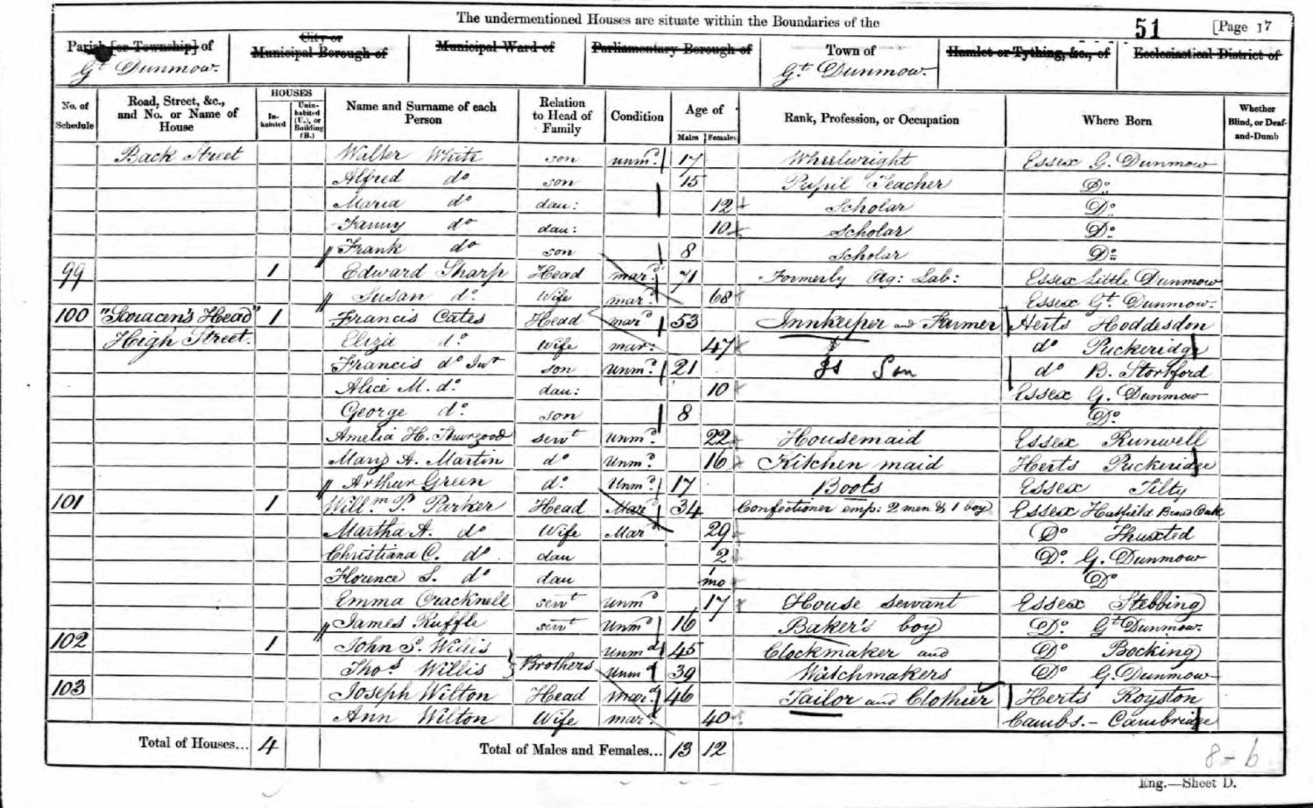
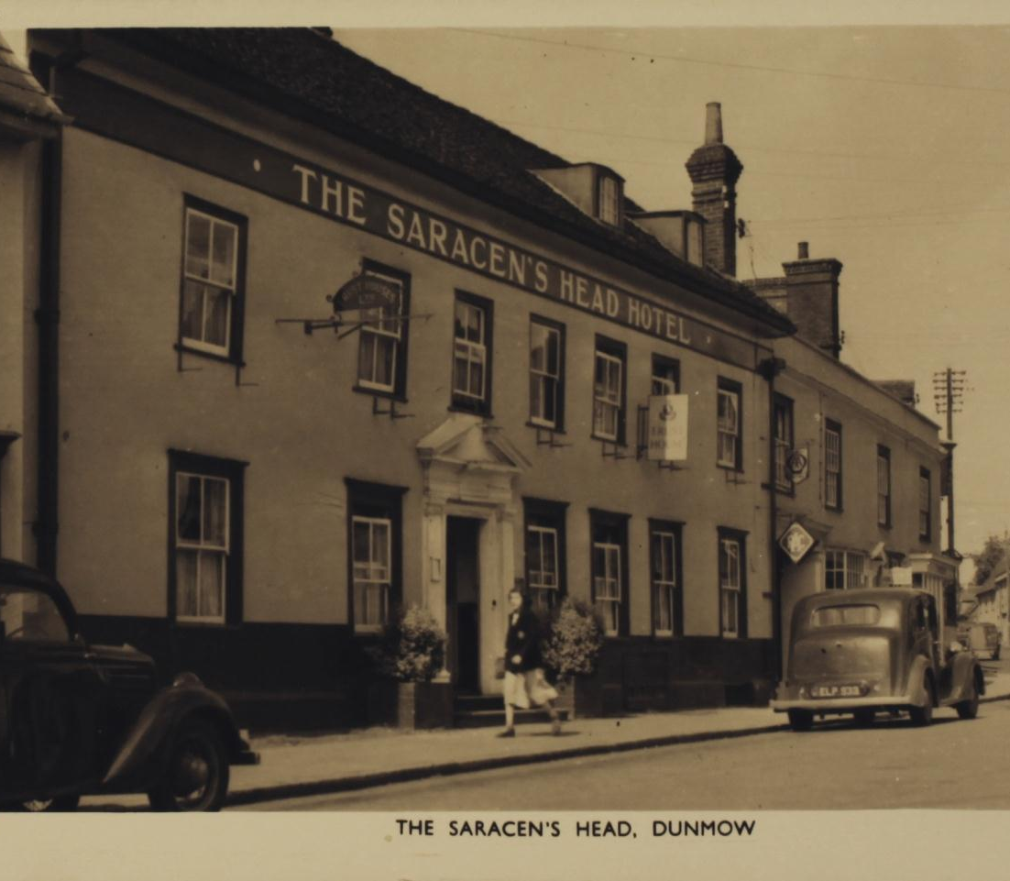
Primary Sources for the Classroom
The Census
Notes:
The census counts everyone living in the UK on a particular day and tells us a little about them – their name, age and where they live. The census is used by the government and local authorities to help plan new schools, houses and roads. A census has been taken regularly in Britain every 10 years since 1841. To keep everyone’s personal information safe we are not able to look at the Census for 100 years. It then becomes interesting for another reason … it is a fantastic source for finding out about the past.

Slide 2
What is the Census?
What is the census?
A. You have five census – seeing, hearing, touching, smelling and tasting
B. The census counts everyone living in the UK on a particular day and tells us a little about them – their name, age and where they live.
B. The census counts everyone living in the UK on a particular day and tells us a little about them – their name, age and where they live.
C. ‘Census’ is a Latin word meaning ‘collection of people’
Notes:
What is the census? (Answer goes pink)

Slide 3
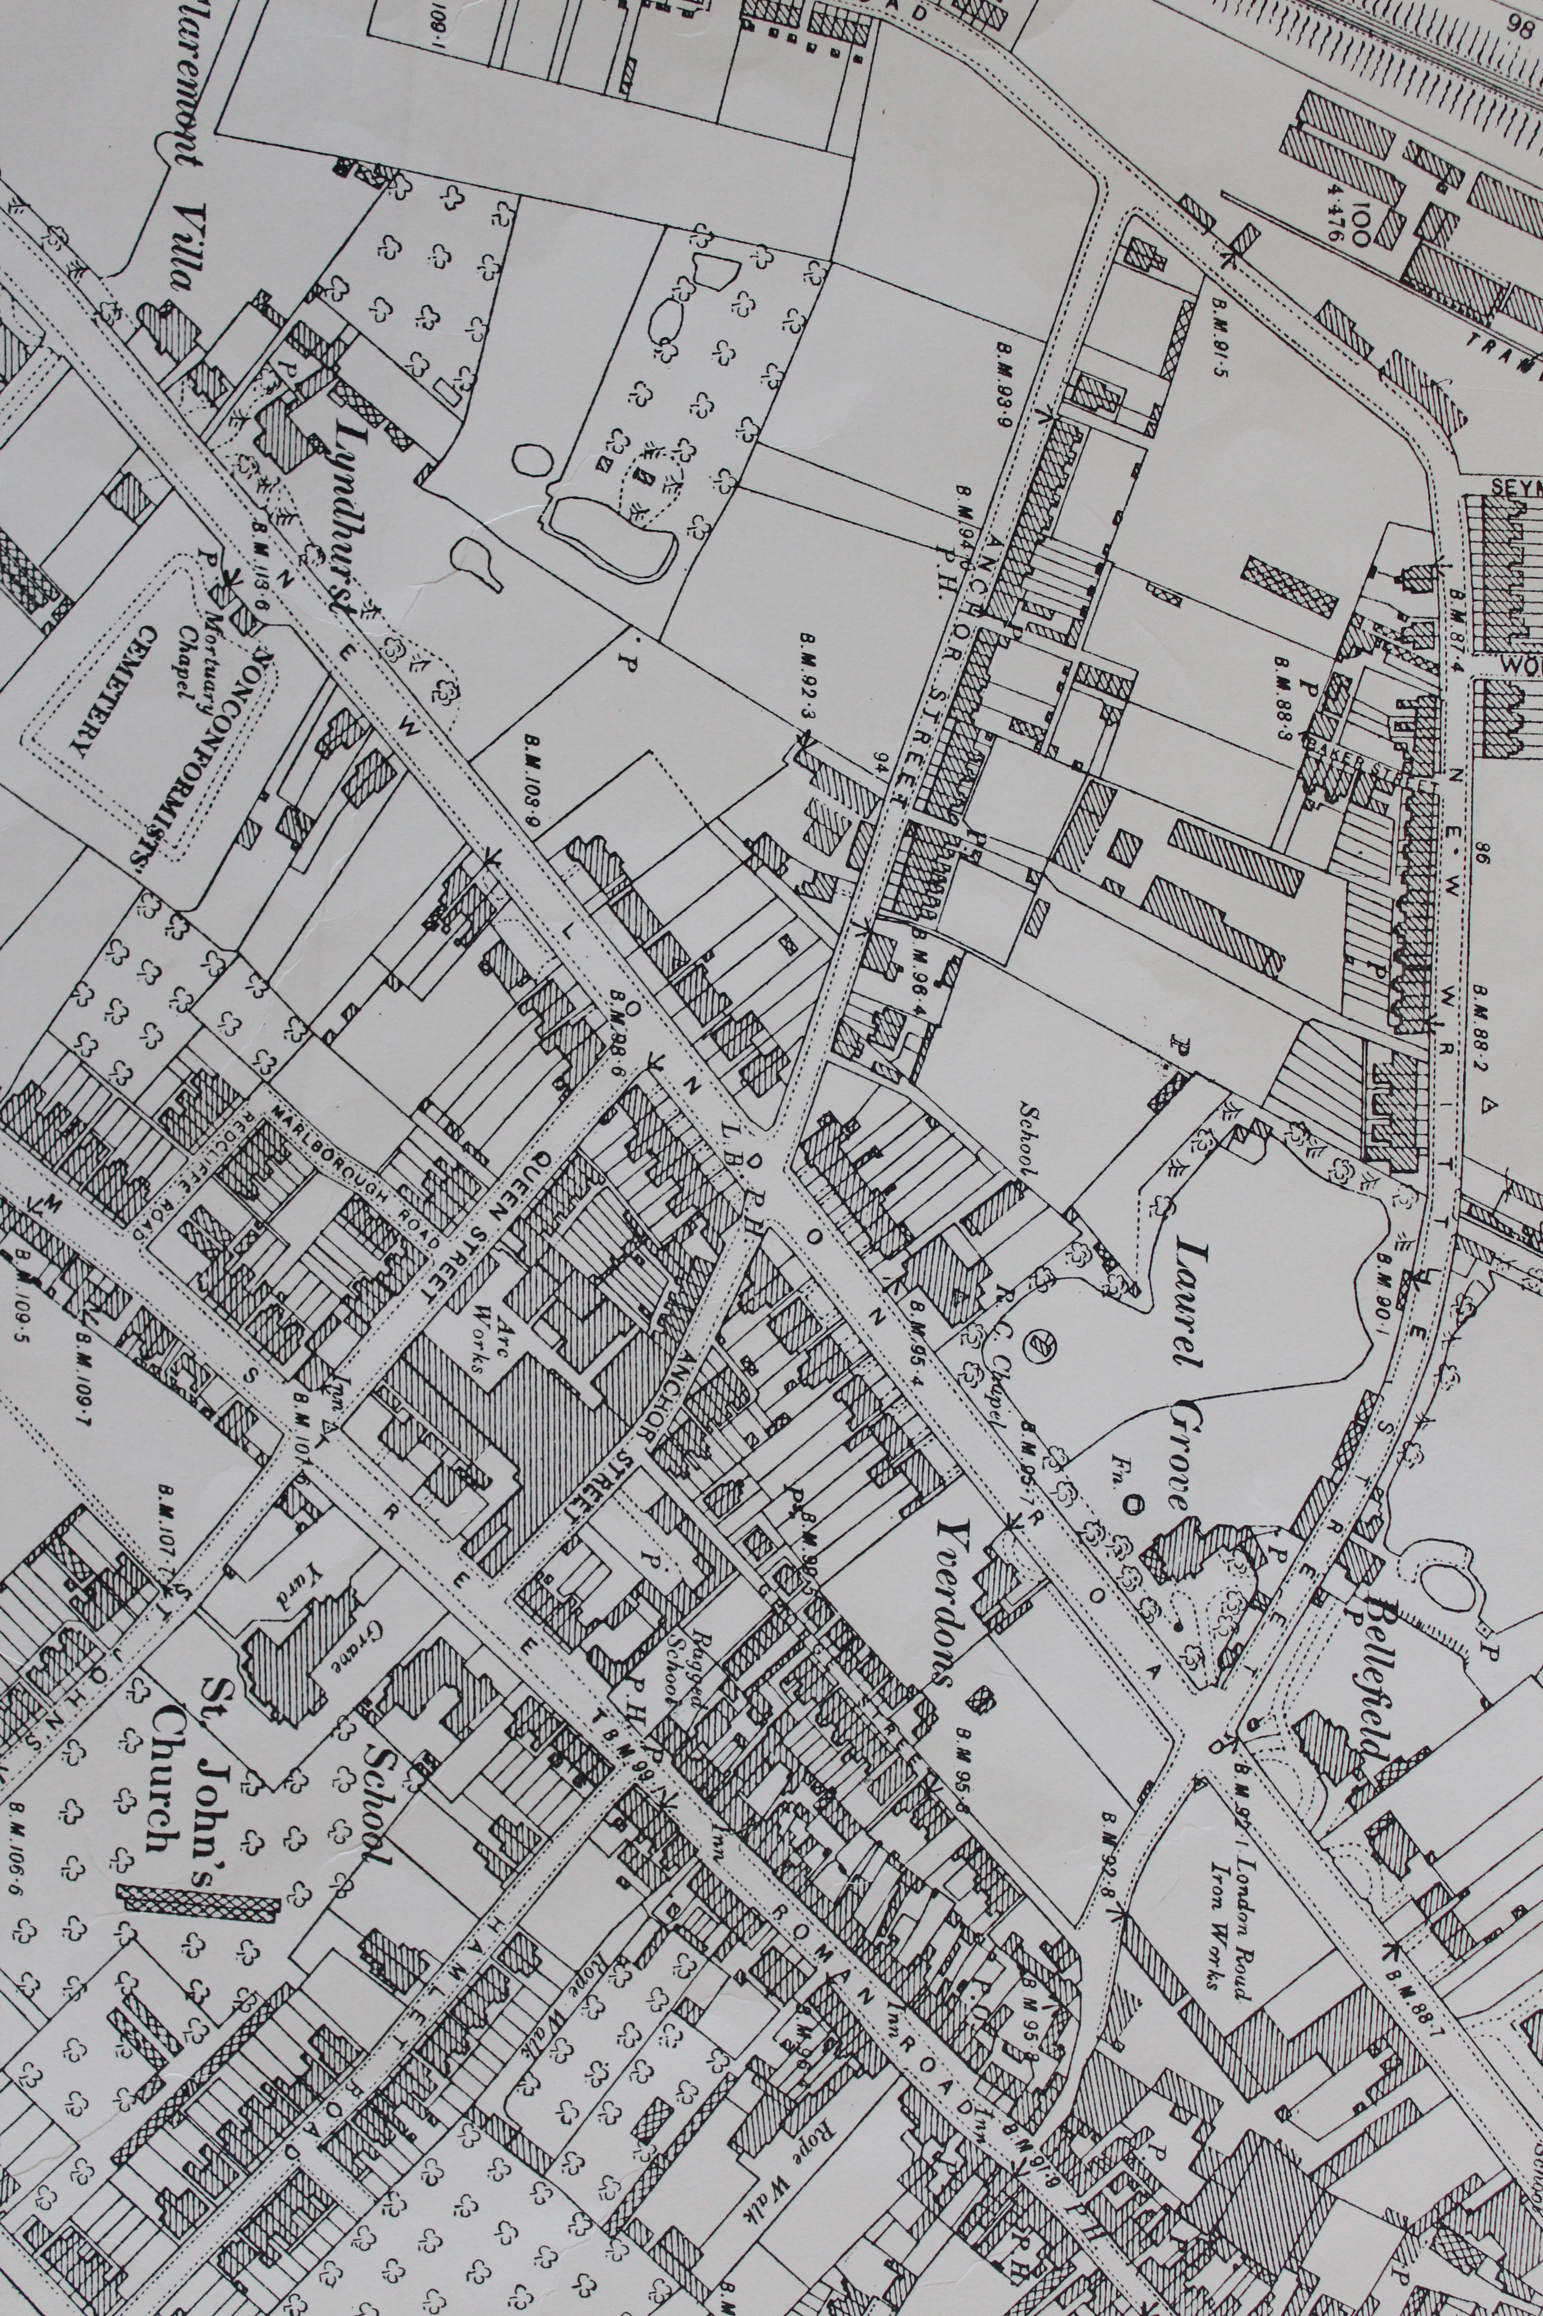
Notes:
2nd addition OS map. 1897. Map 52-8. New London Road, Chelmsford, Essex.
Can you find New London Road (press again to highlight)
Who might live here?
There are children (we can see their schools).
Adults and children might work in the factories (We can see ‘Arc works’ – that supplied electricity to the town (press again for picture) and other factories.)
How could we find out more about the people who lived here? The Census.

Slide 4
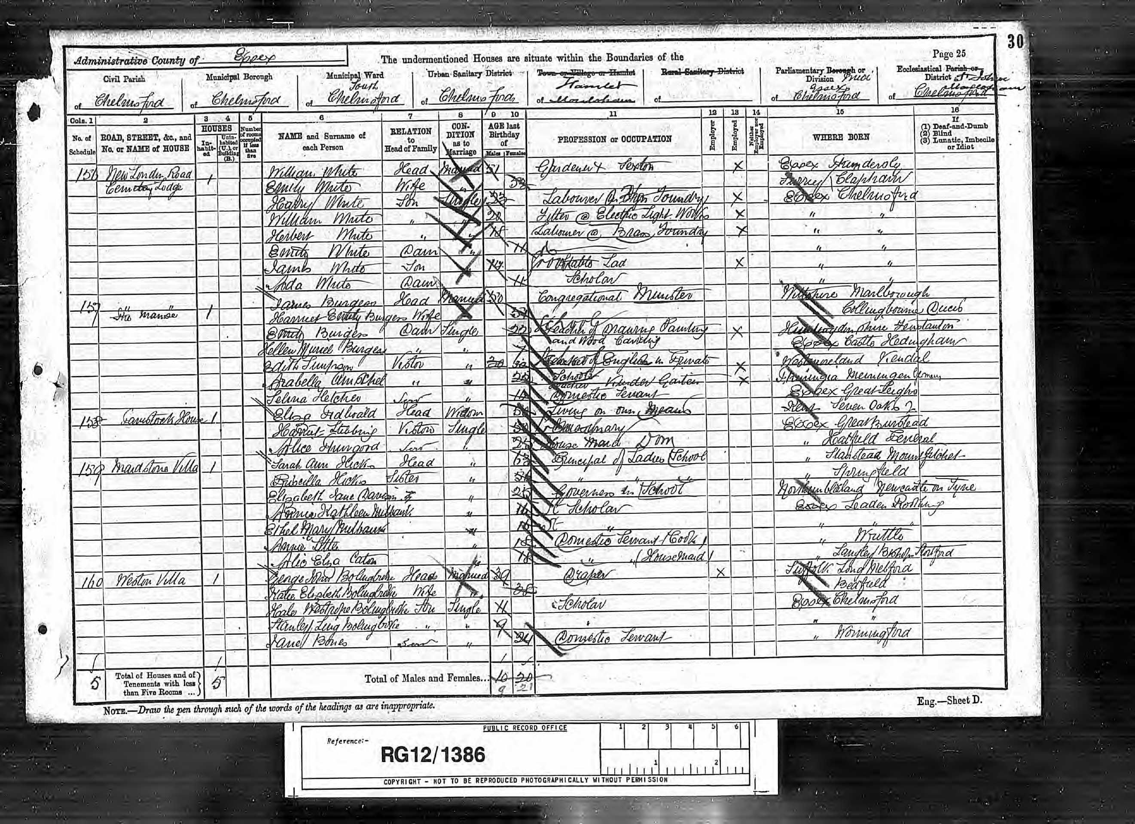
This census was taken Sunday 5th April 1891
Notes:
This census was taken Sunday 5th April 1891 for part of New London Road.
What are the challenges of using this source? Handwriting, the clerks tick off the information they have gathered – making it difficult to see, some symbols and abbreviations that we don’t know.

Slide 5
RELATION to Head of Family will say:
Head, Wife, Dau (daughter), Son, Visitor, Sister or Serv (servant).
‘’ means ‘the same as the box above’
CONDITION as to Marriage will say:
Married, Single or Widow (meaning partner has died)
“ means ‘the same as the box above’
156 | New London Road | 1 |  |  | William White | Head | Married | 51 | Gardner and Sexton
 | Cemetery Lodge |  |  |  | Emily White | Wife | “ | 52
 |  |  |  |  | Harry White | Son | Single | 23 | Labourer @ Iron Foundry
 |  |  |  |  | William White | “ | “ | 20 | Fitter @ Electric Light Works
 |  |  |  |  | Herbert White | “ | “ | 18 | Labourer @ Brass Foundry
 |  |  |  |  | Emily White | Dau | “ | 11
 |  |  |  |  | James White | Son | “ | 14 | Stable Lad
 |  |  |  |  | Ada White | Dua |  | 11 | Scholar
157 | “The Manse” | 1 |  |  | James Burgess | Head | Married | 50 | Congregational Minister
 |  |  |  |  | Harriet Emily Burgess | Wife | “ | 51
 |  |  |  |  | Emily Burgess | Dau | Single | 22 | School teacher of drawing, painting
 |  |  |  |  | Hellen Muriel Burgess | “ | “ | 7 | and wood carving
 |  |  |  |  | Edith Simpson | Visitor | “ | 30 | Teacher of English in Private
 |  |  |  |  | Arabella Amschel | “ | “ | 22 | School Teacher Kinder Garten
 |  |  |  |  | Selina Fletcher | Serv | “ | 14 | Domestic Servant
158 | Gavistock House | 1 |  |  | Eliza Fidbrald | Head | Widow | 50 | Living on own means
 |  |  |  |  | Harriet Stebbing | Visitor | Single | 50 | ?
 |  |  |  |  | Alice Thurgood | Serv | “ | 25 | House maid Dom (domestic)
159 | Maidstone Villa | 1 |  |  | Sarah Ann Hicks | Head | “ | 63 | Principal of Ladies School
 |  |  |  |  | Priscilla Hicks | Sister | “ | 56 | “ “
 |  |  |  |  | Elizabeth Jane Davidson |  | “ | 25 | Governess in School
 |  |  |  |  | Annie Kathleen Milbank |  | “ | 16 | St Scholar
 |  |  |  |  | Ethel Mary Milbank |  | “ | 16 | St “
 |  |  |  |  | Annie Little |  | “ | 18 | Domestic Servant (Cook)
 |  |  |  |  | Alic Eliza Caton |  | “ | 18 | “ (Housemaid)
 | X |  | Essex, ???mdersly
 |  |  | Surrey, Clapham
 | X |  | Essex, Chelmsford
 | X |  | “ “
 | X |  | “ “
 |  |  | “ “
 | X |  | “ “
 |  |  | “ “
 |  |  | Wiltshire, Marlborough
 |  |  | Collingbourne Ducis
 | X |  | Huntingdonshire, Fenstanton
 |  |  | Essex, Castle Hedingham
 | X |  | Westmorland, Kendal
 | X |  | Thuringia Memmingen Germany
 |  |  | Essex, Great Leighs
 |  |  | Kent, Seven Oaks
 |  |  | Essex, Great Burstead
 |  |  | “ Hatfield Perverel
 |  |  | “ Stanstead Mountfitchet
 |  |  | “ Springfield
 |  |  | Northumberland, Newcastle on Tyne
 |  |  | Essex, Leaden Roding
 |  |  | “ “
 |  |  | “ Writtle
 |  |  | “ Langley Bishop Stortford
Notes:
What can we find out from looking at this census?
Who is the oldest? The youngest?
Can you find a scholar (a child who goes to school)?
Who does a job you’ve heard of? Is there a job you haven’t heard of?
Who was born furthest away?

Slide 6
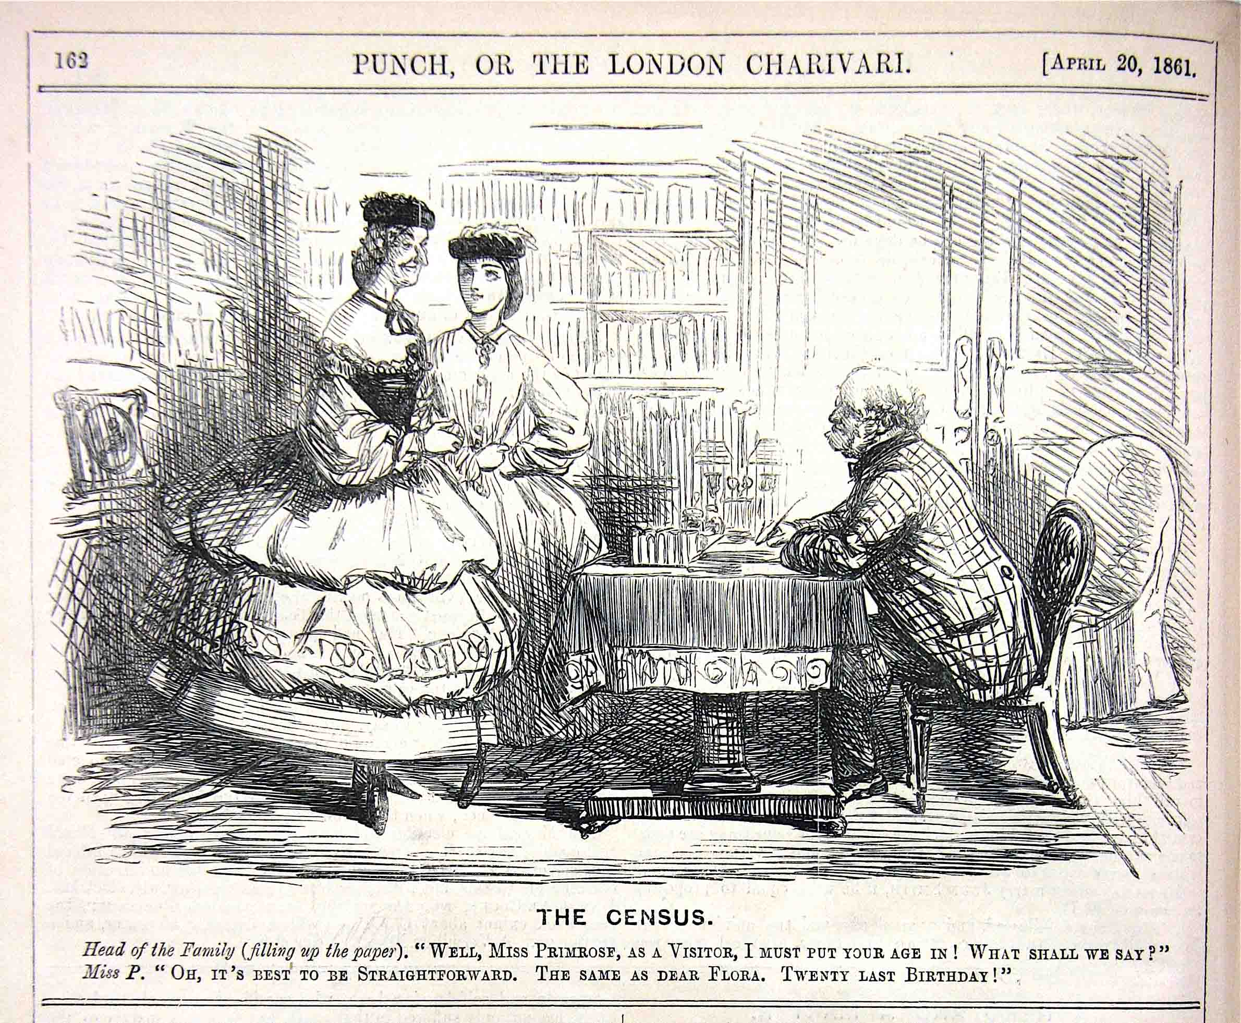
A census has been taken regularly in Britain every 10 years since 1841.
How was the information gathered?
Notes:
How was the information gathered?
After 1911 each household would write their own information down.
In Victorian Times (when many people could not read or write) a census taker, like the gentleman pictured would come to your house and ask questions.
Sometimes they got things wrong. Sometimes people told lies (like the lady above lying about her age).

Slide 7
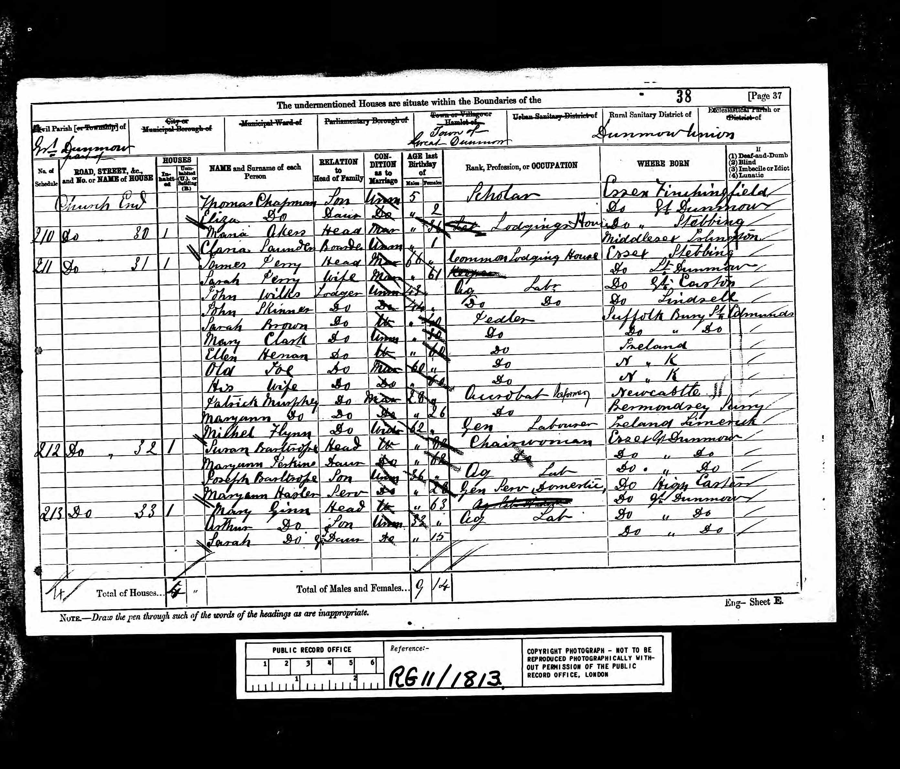
Notes:
This is a census from 1881. The landlord has a number of lodgers staying in his house. Including old Joe … it looks like the landlord has forgotten his surname.
Even worse, he has forgotten Old Joe’s wife's first name and surname.

Slide 8
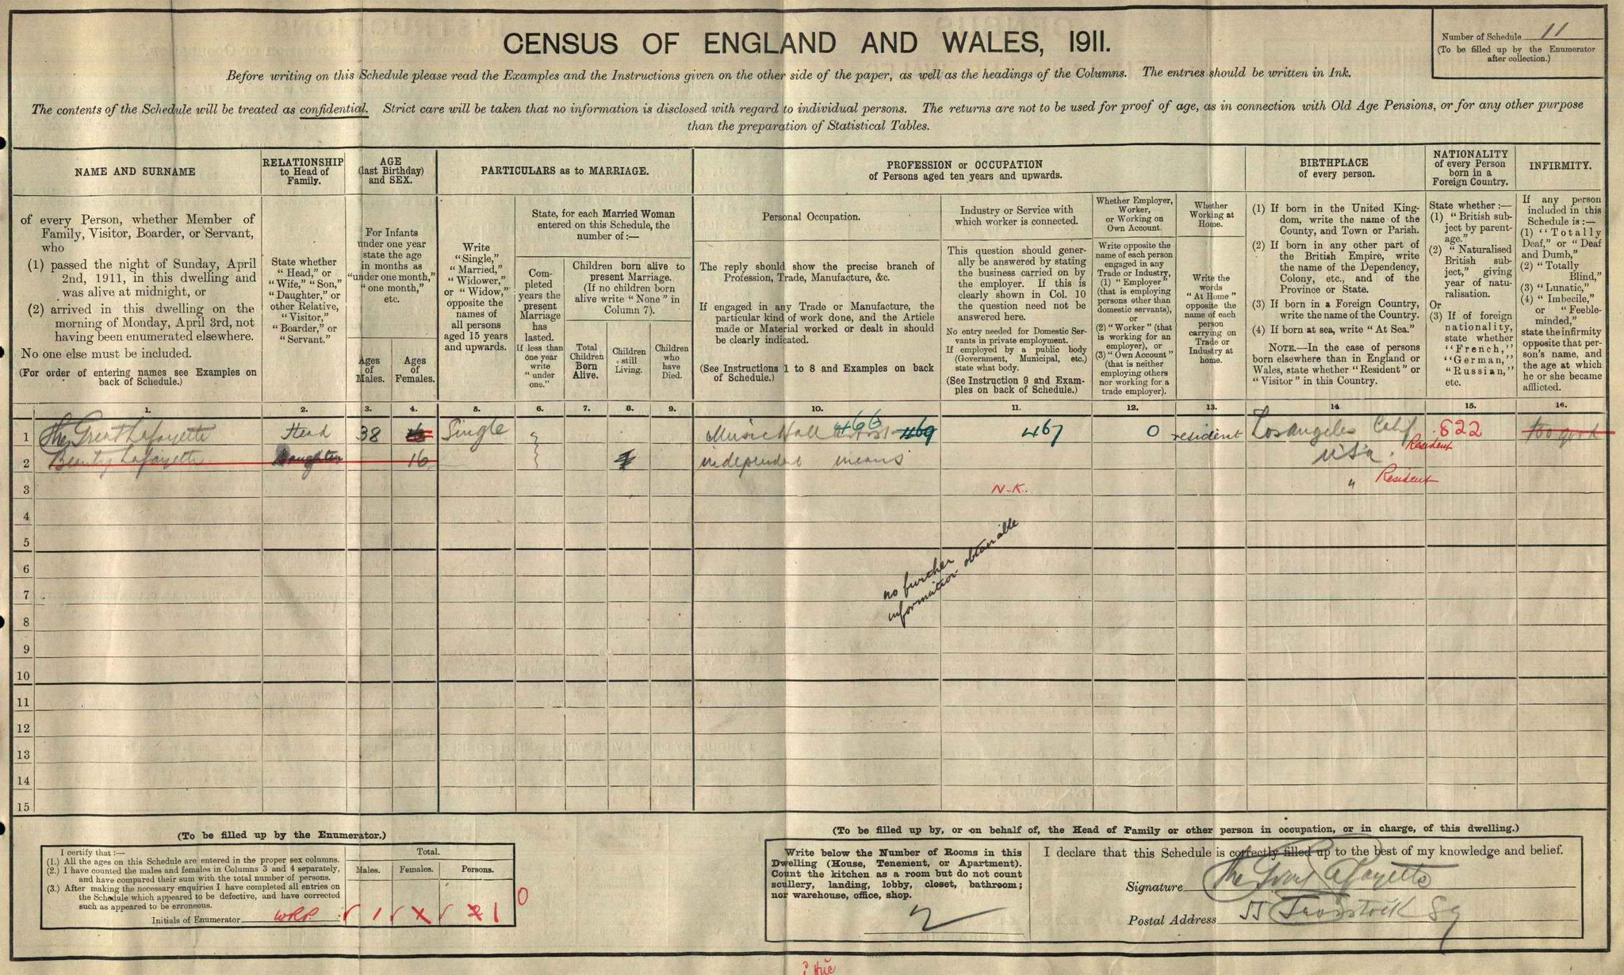
Notes:
The magician, the Great Lafayette (probably not his real name) in the 1911 census, gave his disability as "too good" and listed his treasured dog Beauty as his daughter! (press again to zoom in)
The annoyed clerk has crossed it out with red pen.
Found and posted by Dapper Historian. Twitter. https://twitter.com/DapperHistorian

Slide 9
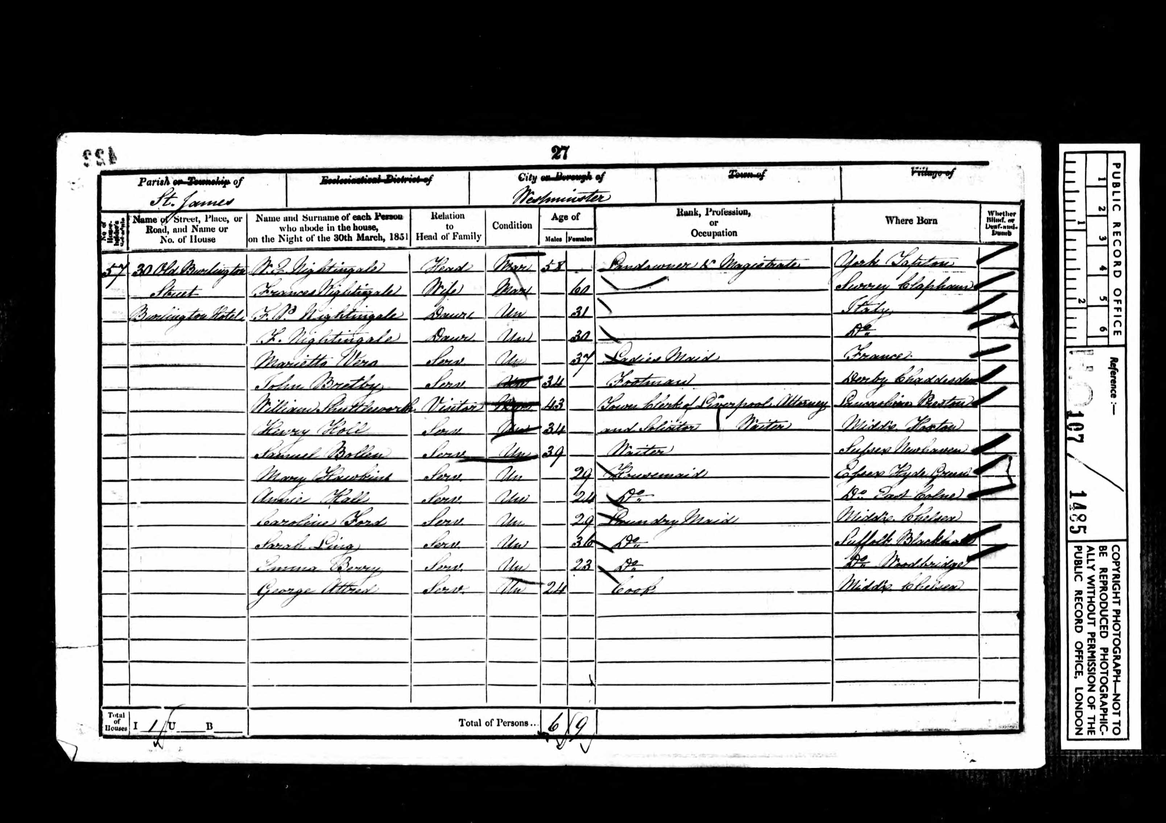
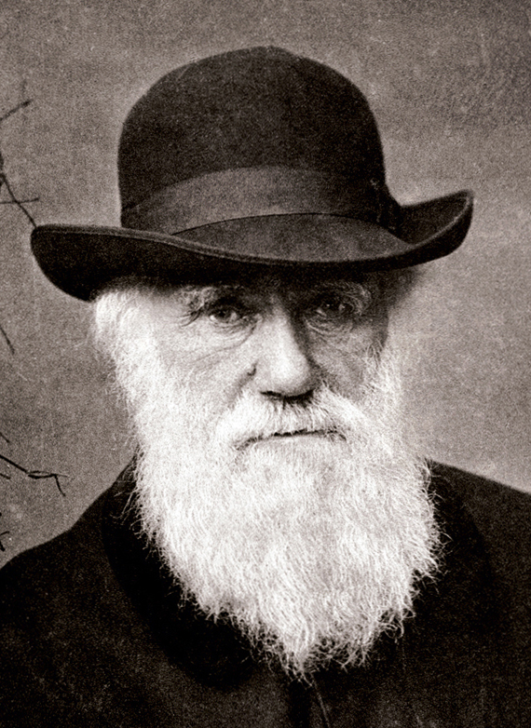
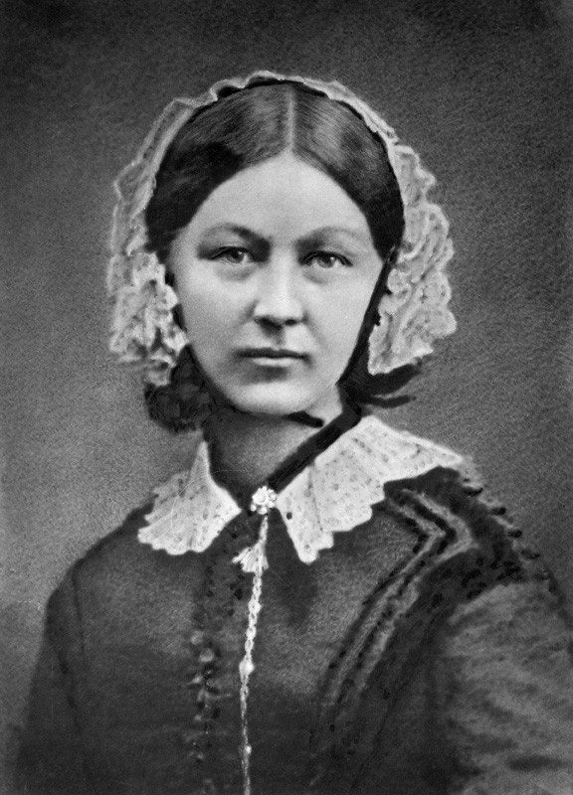
The Census: Significant Individuals
Notes:
Significant individuals
Famous people are also recorded on the census.

Slide 10
Charles Darwin
Notes:
Discuss in pairs: What do you think Charles Darwin put as his job? Scientist, explorer, writer of ‘The Origin of Species’?

Slide 11
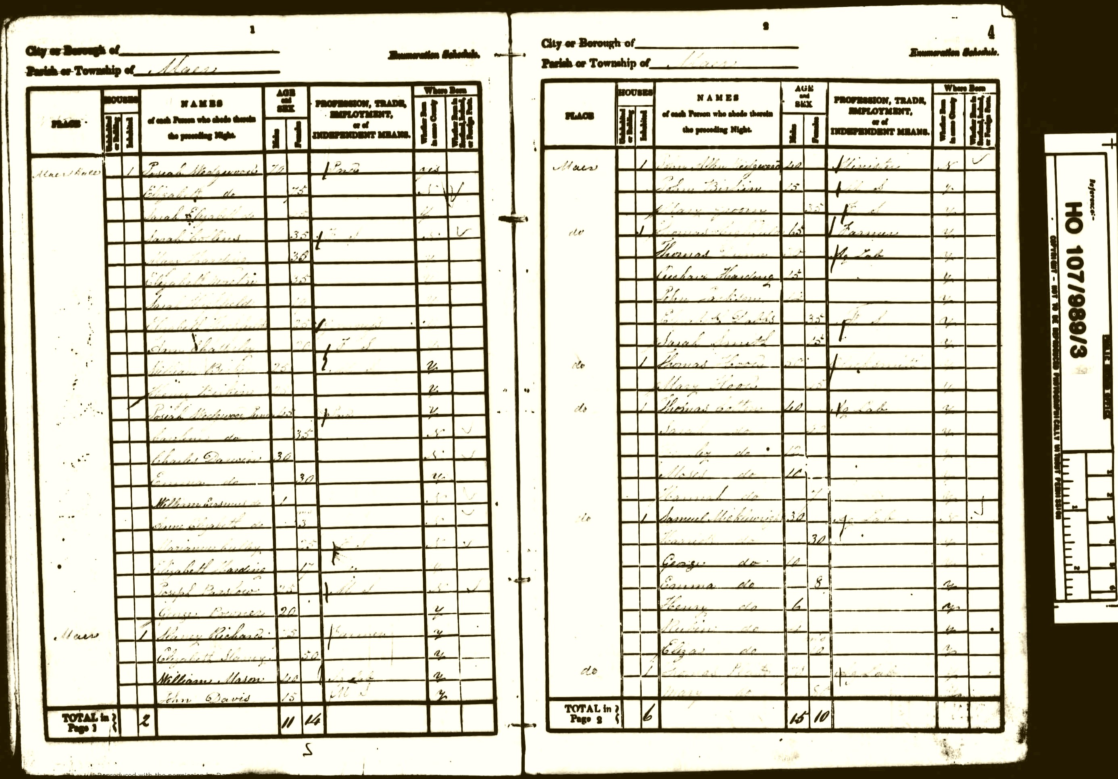
1841 – age 30 – no job listed
Notes:
1841 – age 30 – no job listed

Slide 12
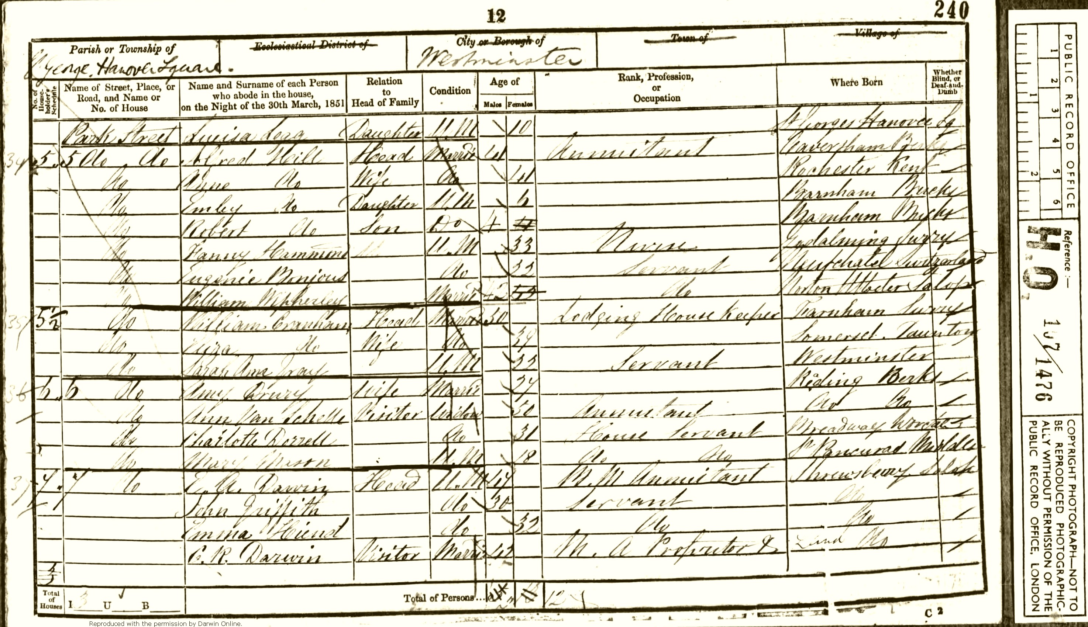
1851 – M.A. professor?
Notes:
1851 – age 40 - M.A. professor?

Slide 13
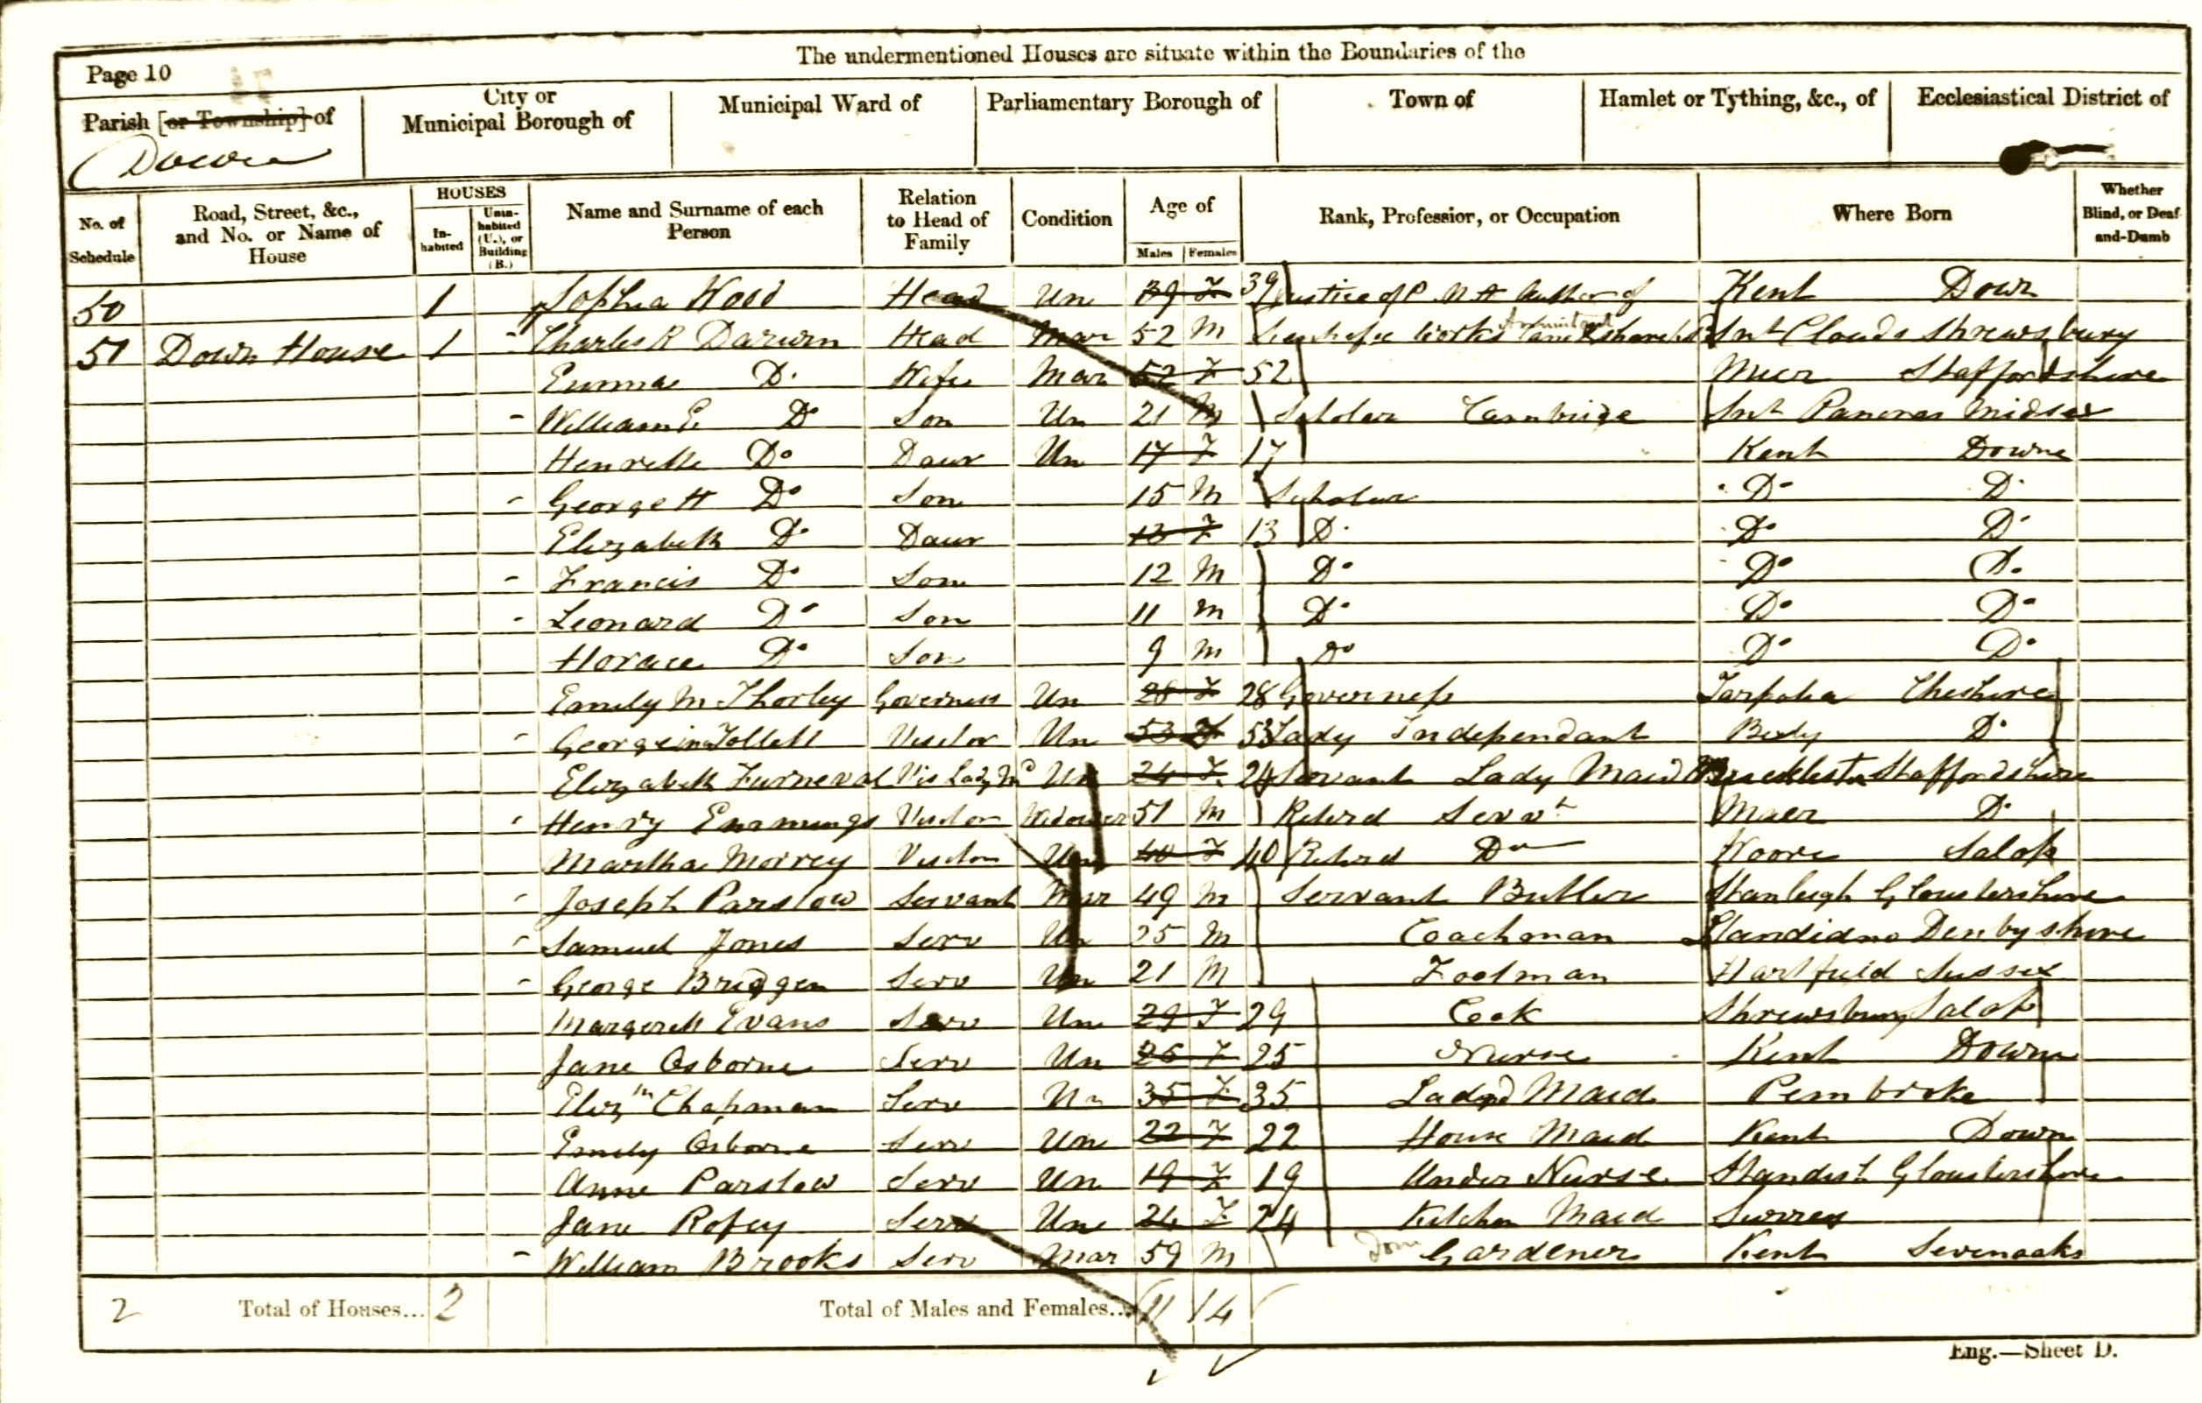
Author of scientific works
1861 – age 50 - Justice of the P / M.A. / Author of Scientific Works
Notes:
1861 – age 50 - Justice of the P / M.A. / Author of Scientific Works
He never wrote that he was a scientist or an explorer - Does this surprise you?

Slide 14
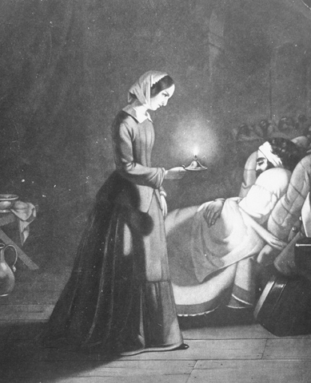
Florence Nightingale.
Notes:
A lot can change in 10 years (the time between each census) – just ask this famous Victorian nurse. Florence Nightingale.

Slide 15
Florence Nightingale – 1851 – living with her parents
Notes:
In 1851 she was living with her parents. After this she became a nurse, tended the wounded of the Crimean War, showed that trained nurses and clean hospitals could save hundreds of lives, set up a training hospital and is credited with founding modern nursing. Became famous – was in the newspaper and was very well known.

Slide 16
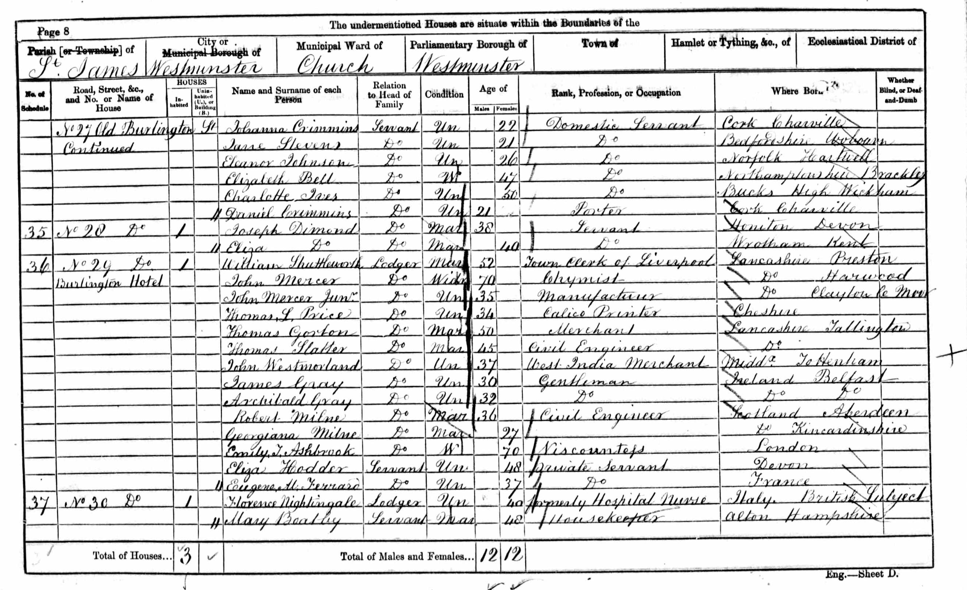
Florence Nightingale – 1861 – ‘formerly hospital nurse’
Notes:
In 1861 she is ‘formerly Hospital Nurse’.

Slide 17
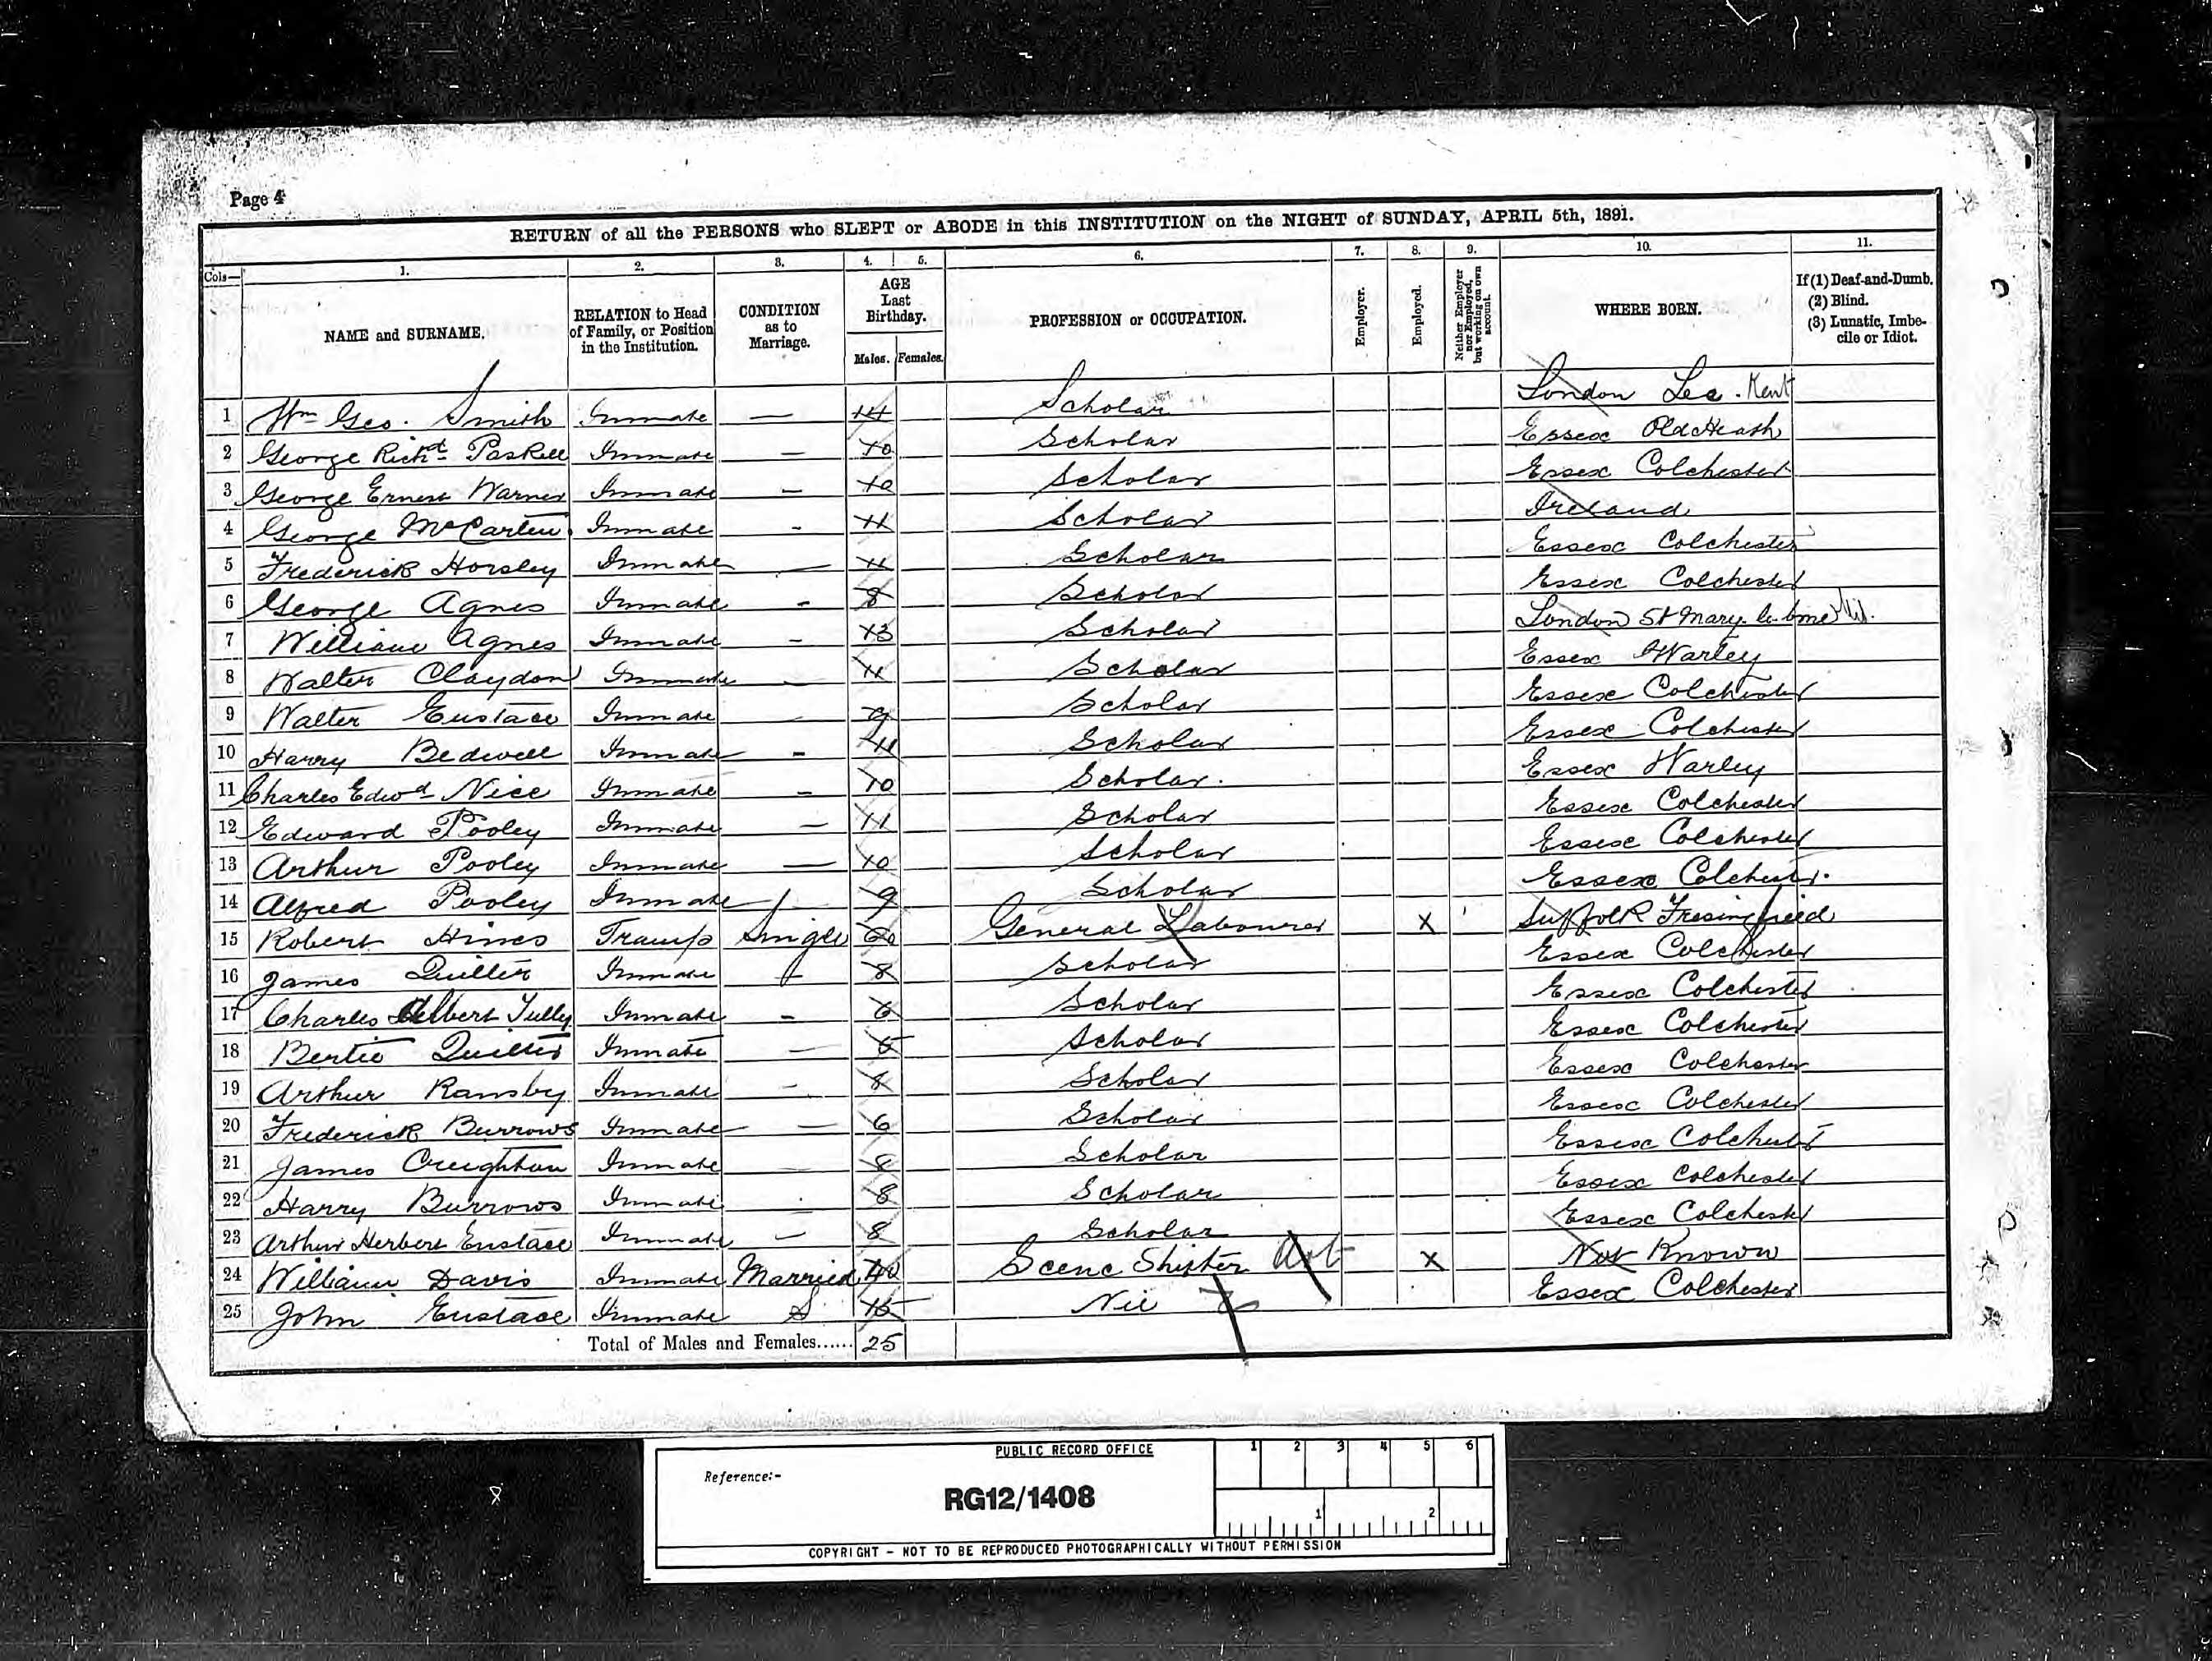
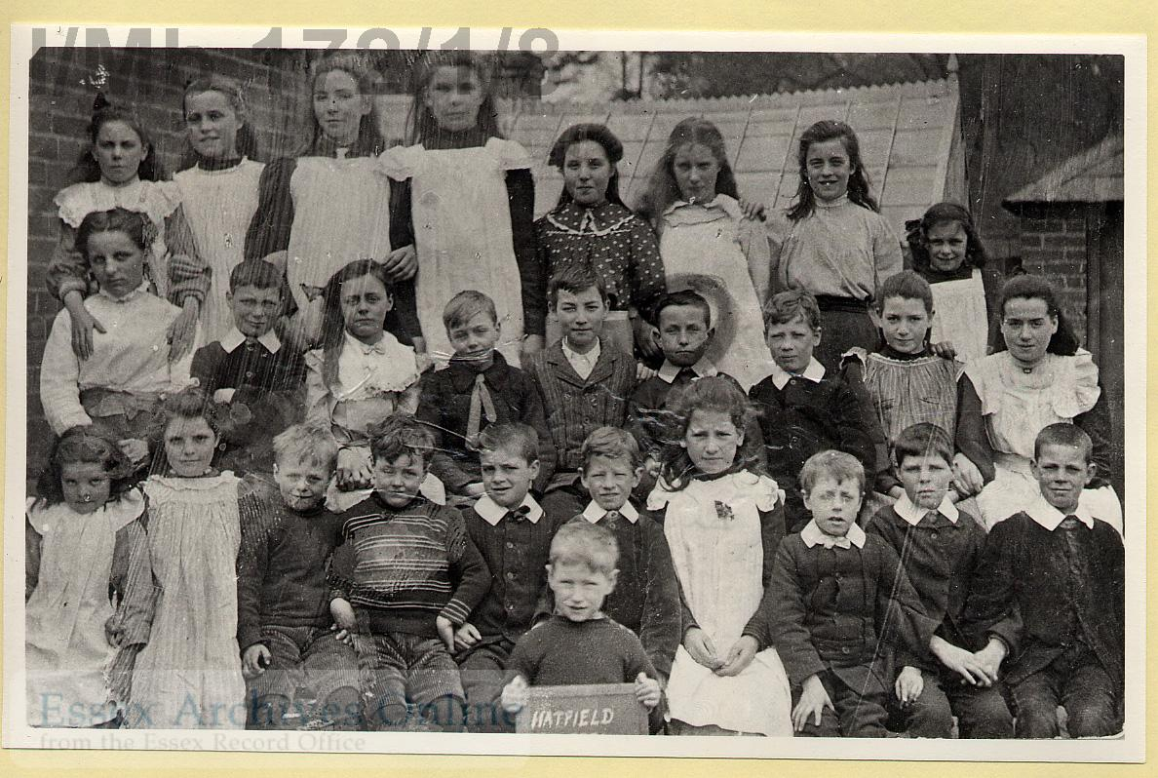
The Census: Poor children
Notes:
Children in the census.
What can we discover about the lives of Victorian children?

Slide 18
Notes:
This page shows some of the boys described as ‘inmates’ at Colchester Union Workhouse in 1891.
By this time school is free and compulsory for all children and we know at this time North School in Colchester, nearby and newly built accepted some of these children as students.
How could this have changed these children’s lives?

Slide 19
1894
Friday afternoon Nov 23rd
According to arrangement
45 children from the Colchester Workhouse
Were admitted to the school.
Notes:
Work house children were supposed to go to school. There was a work house only 10 minutes walk from North School.
November: How many children does the Head Teacher agree to take?
He waits for them to turn up.

Slide 20
A communication has been received from the master of the workhouse stating that as such a large proportion of the children are ill, the doctor has advised that all be kept at home till after Xmas. At my request, seeing that this would seriously affect the average attendance, this arrangement has been modified by detaining only the worst cases.
Notes:
December: nearly a month later.
Have the work house children been allowed to go to school? No
Why not? Supposedly many are ill and all are being kept in (home for them is the workhouse)
There are many excuses given and the workhouse children keep missing school. The head teacher doesn’t believe that they are all ill and asks that some be allowed out.
What could be happening?
They could really be ill
The master is afraid that they will run away if he lets them out
The master earns money from work the children do. He wants them to do work and not go to school.

Slide 21
The Census: Children
Notes:
Children in the census.
What can we discover about the lives of ordinary Victorian children?

Slide 22
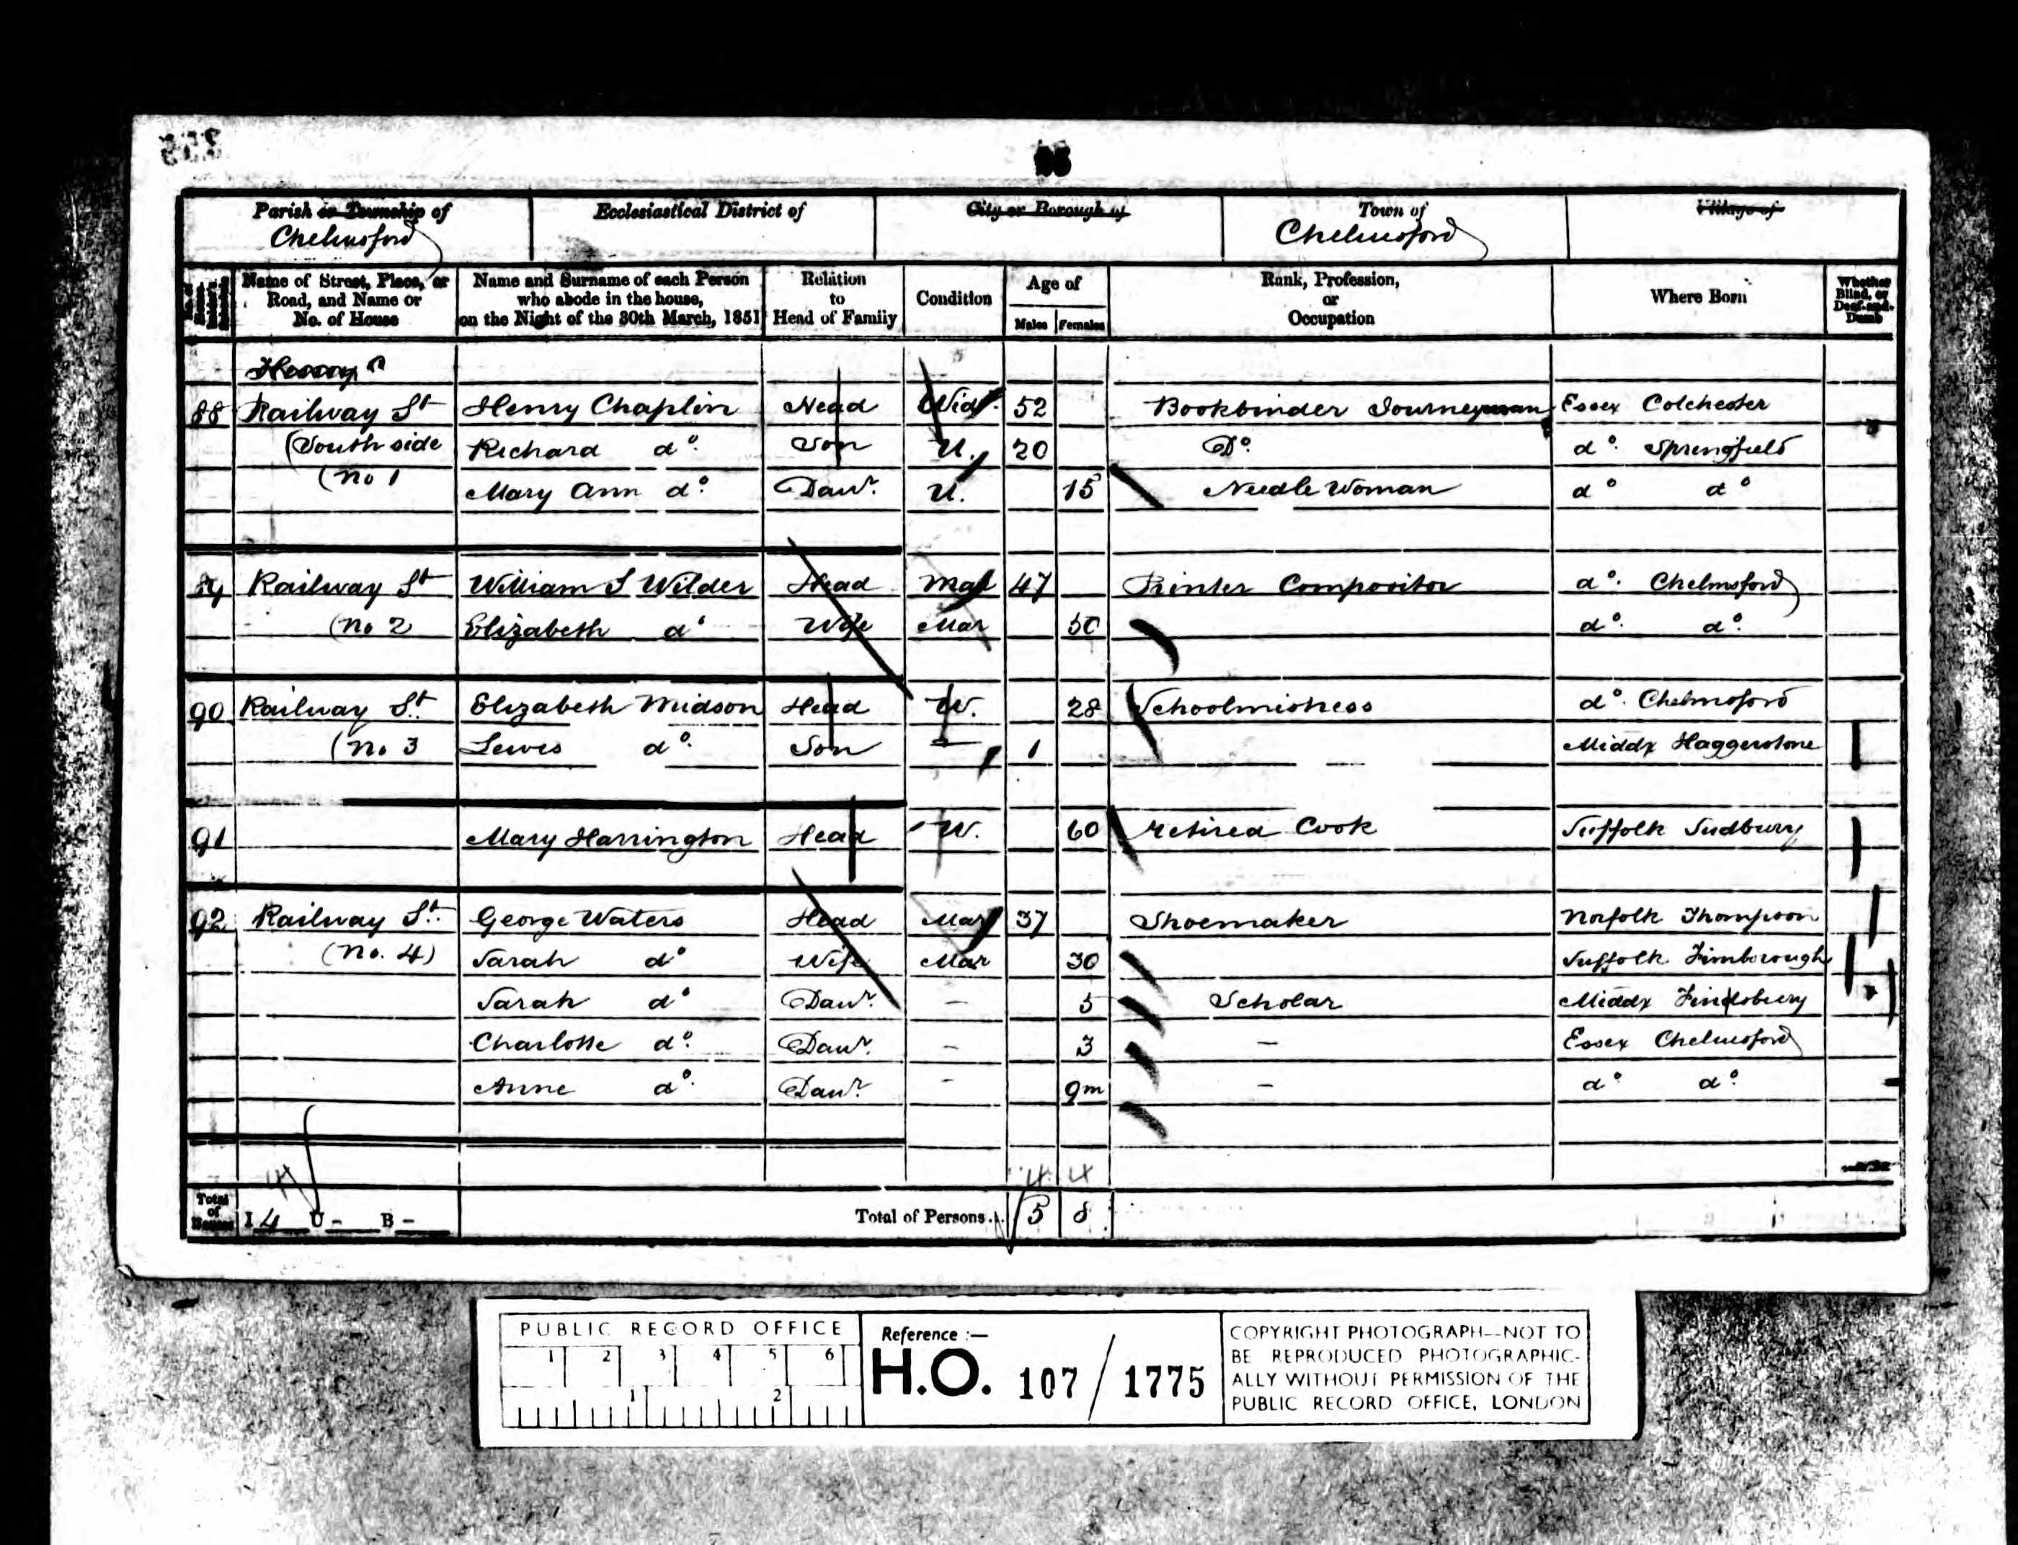
Notes:
Start by challenging children’s information retrieval skills, asking what information they can gather from this 1851 census. Perhaps choose one person to be the character in a story – what do we know about them? How can we create a story from this?

Slide 23
Sarah Waters awoke with a start.
“Sarah” she heard her father call urgently, “Sarah! Anne needs you!”
She suddenly realised that he wasn’t calling her, he was calling her mother. Sarah’s baby sister Anne was crying again. Sarah was glad she had woken up, because It was nearly time to school.
Sarah made her way downstairs through her father’s shoe making workshop. The overwhelming smell of leather and glue made her feel a little dizzy, but she soon got used to it.
Sarah stepped out of her house on Railway Street. It was so different to their old home in Middlesex. There had been strong, green trees and fresh, clear air. Railway Street was always dirty from the factories nearby pumping smoke from their chimneys. Sarah was on her best behaviour, as quiet as a mouse, when she walked past the house next door. It belonged to Mrs. Midson her strict, scary school teacher.
Notes:
Sarah’s story could start like this.

Slide 24
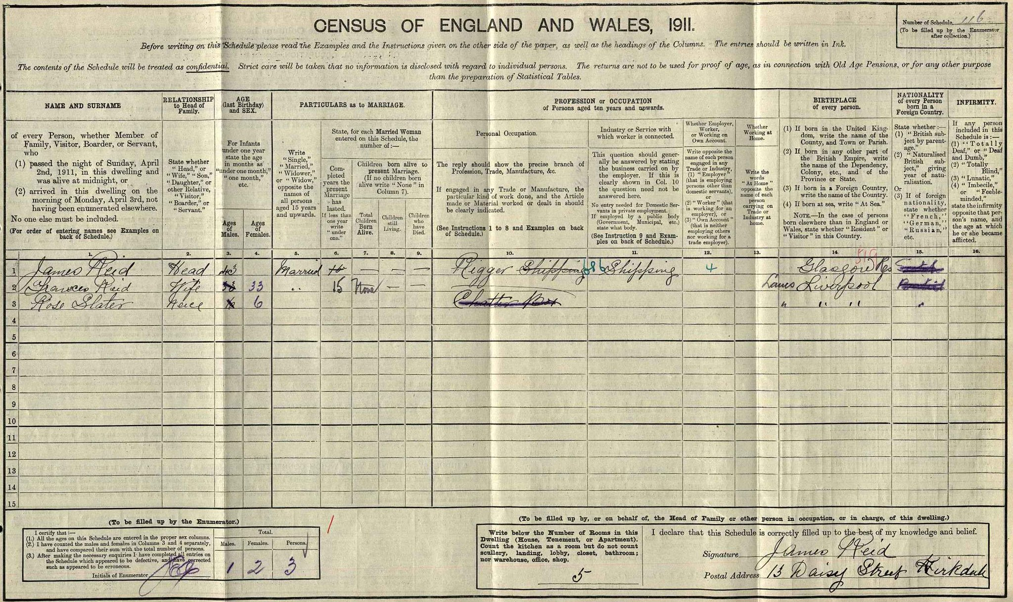
Notes:
Rose Slater/ Niece / 6 years old / Occupation ChatterBox /Liverpool Family 1911 census.
Rose has the occupation ‘ChatterBox’!
Found and posted by Dapper Historian. Twitter. https://twitter.com/DapperHistorian

Slide 25
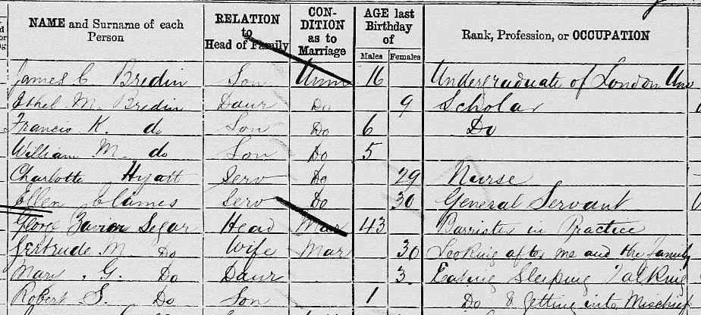
Notes:
Mary/ Daughter / 3 years old / Occupation “eating, sleeping & talking” /1881 census
Robert / Son / 1 year old / Occupation “Do” (means ditto – so eating, sleeping and talking the same as the writing in the box above) & “Getting into mischief”
Found and posted by Dapper Historian. Twitter. https://twitter.com/DapperHistorian

Slide 26
Notes:
Charles Ellis / 7 years old / Occupation “goes to school, whistling as he goes” /1851 census
Found and posted by Dapper Historian. Twitter. https://twitter.com/DapperHistorian

Slide 27
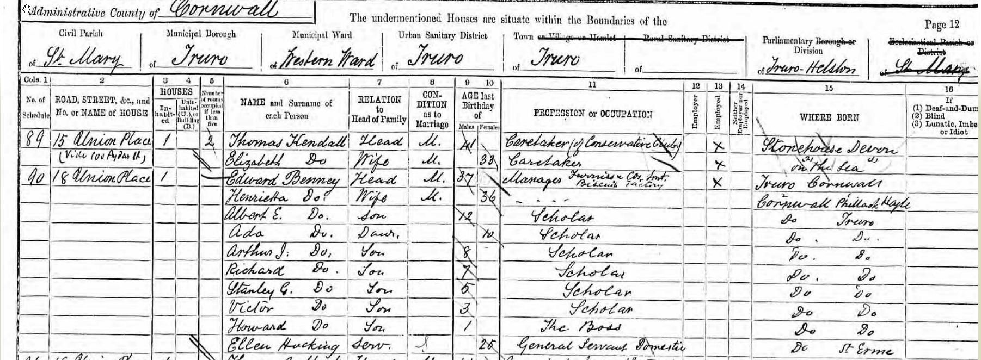
Notes:
Howard Benny / Son / 1 year old / Occupation “The Boss” /1891 census
Found and posted by Dapper Historian. Twitter. https://twitter.com/DapperHistorian

Slide 28
Notes:
You can print out or zoom in to any of the slides included here.
A ‘census day’ at school could include lessons across the curriculum.

Slide 29
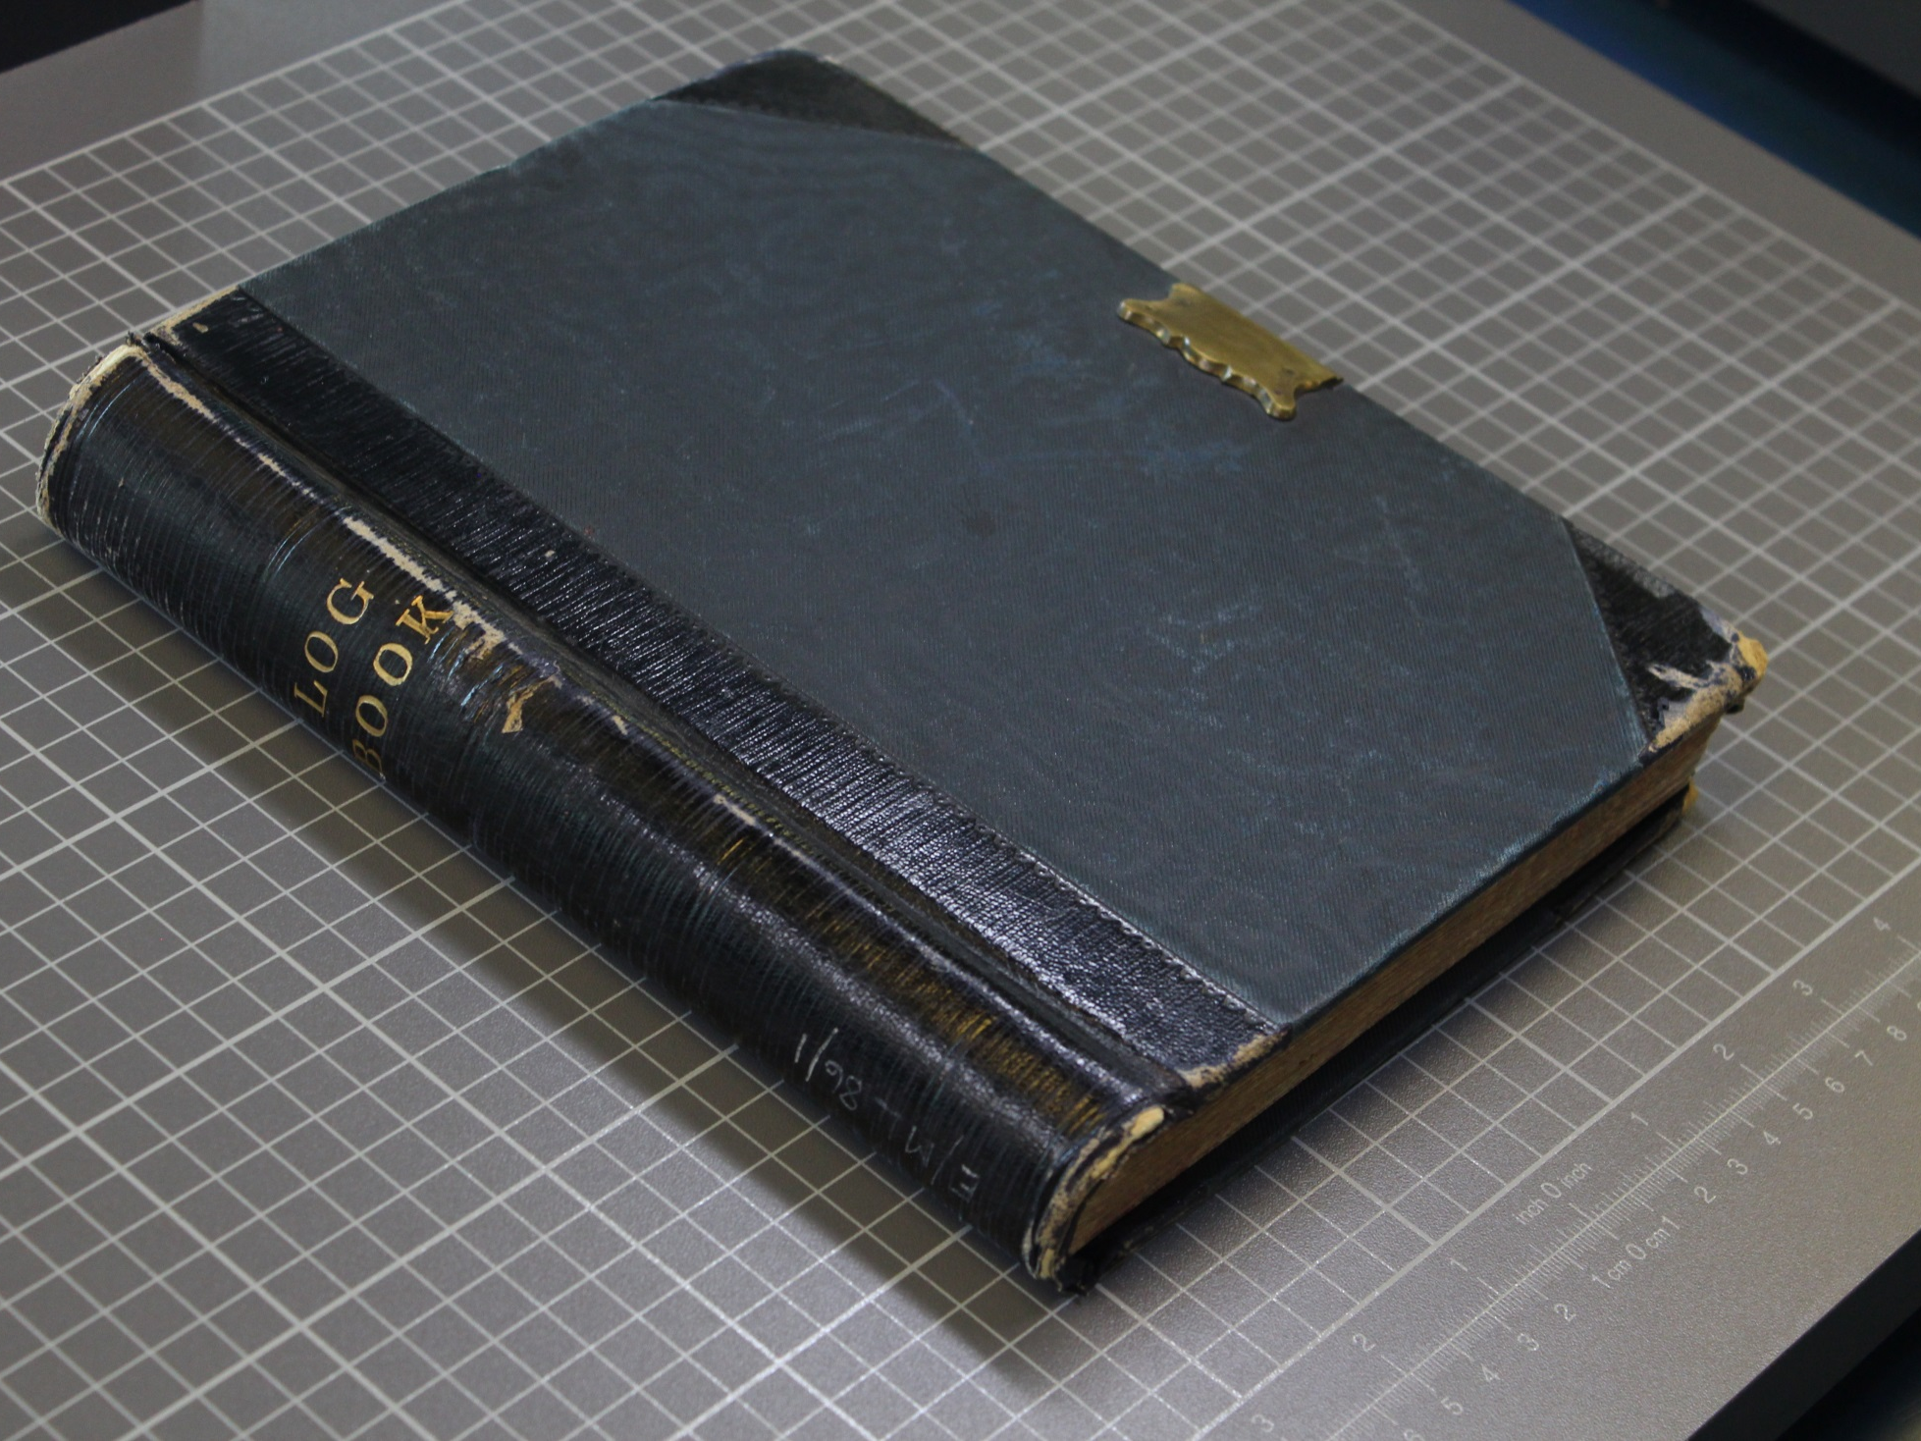
Was this useful to you?
Help us shape our content and share good ideas for other teachers.
E-mail Valina at:
heritage.education@essex.gov.uk
Notes:
Was this useful to you?
Help us shape our content and share good ideas for other teachers.
E-mail Valina at:
heritage.education@essex.gov.uk

