Slide 1
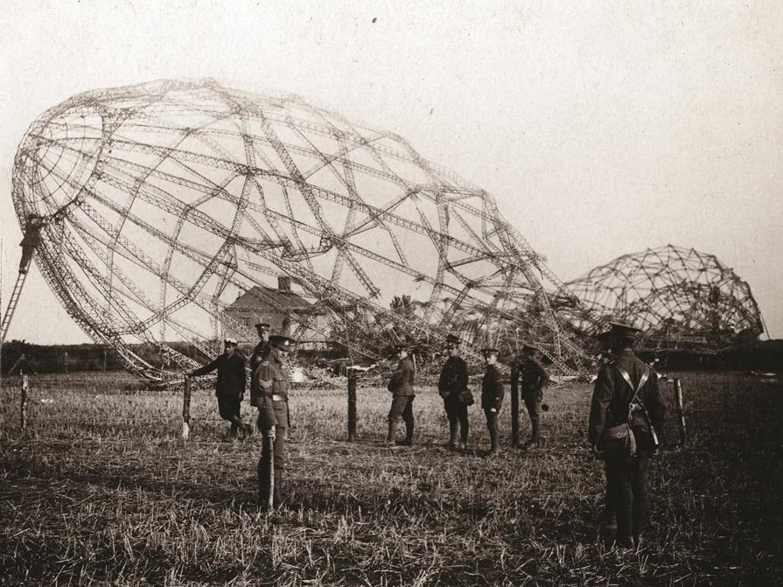

Essex at War
1914-1918
Resources from the Essex Record Office

Slide 2
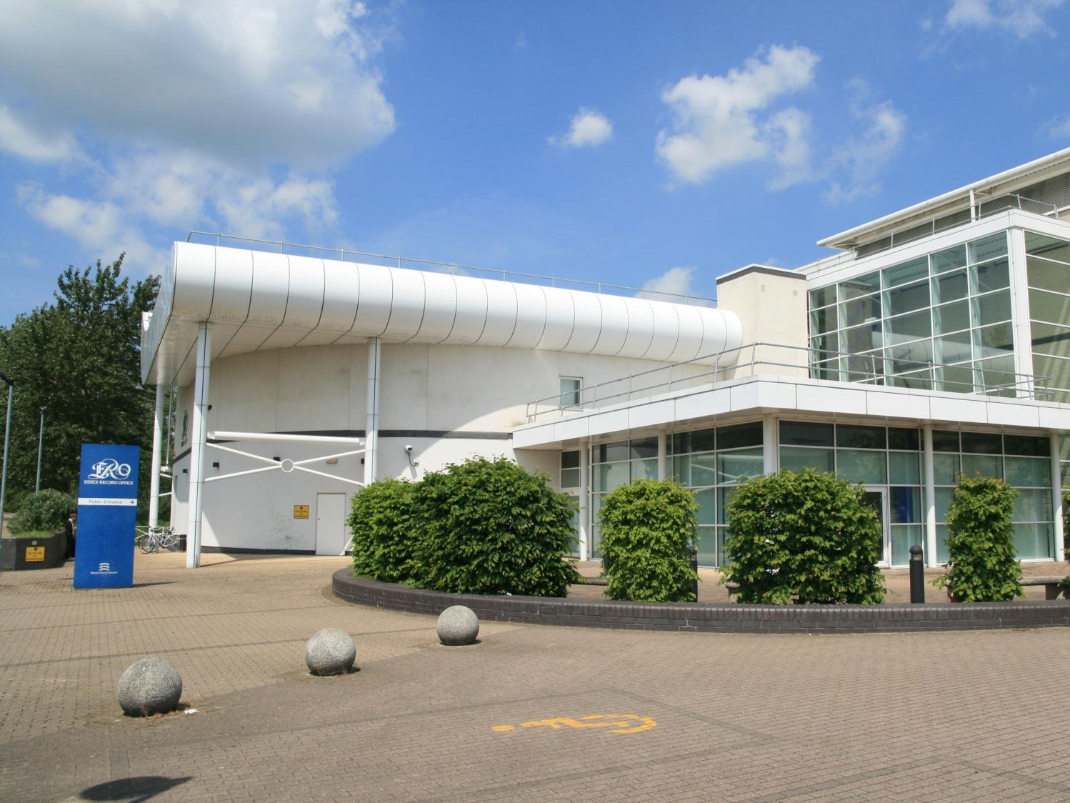
What is the Essex Record Office?

Slide 3
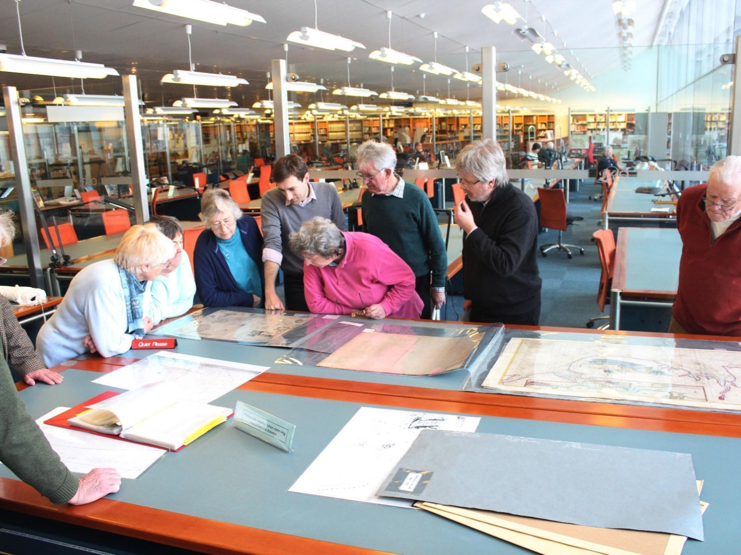

Slide 4
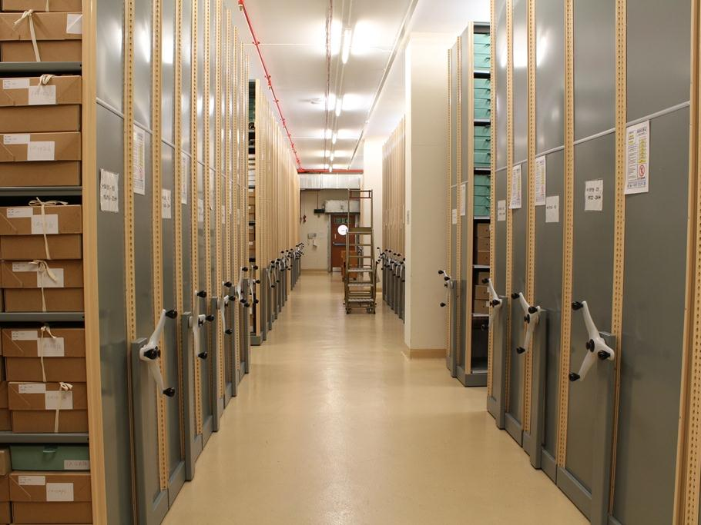
8 miles of shelves

Slide 5
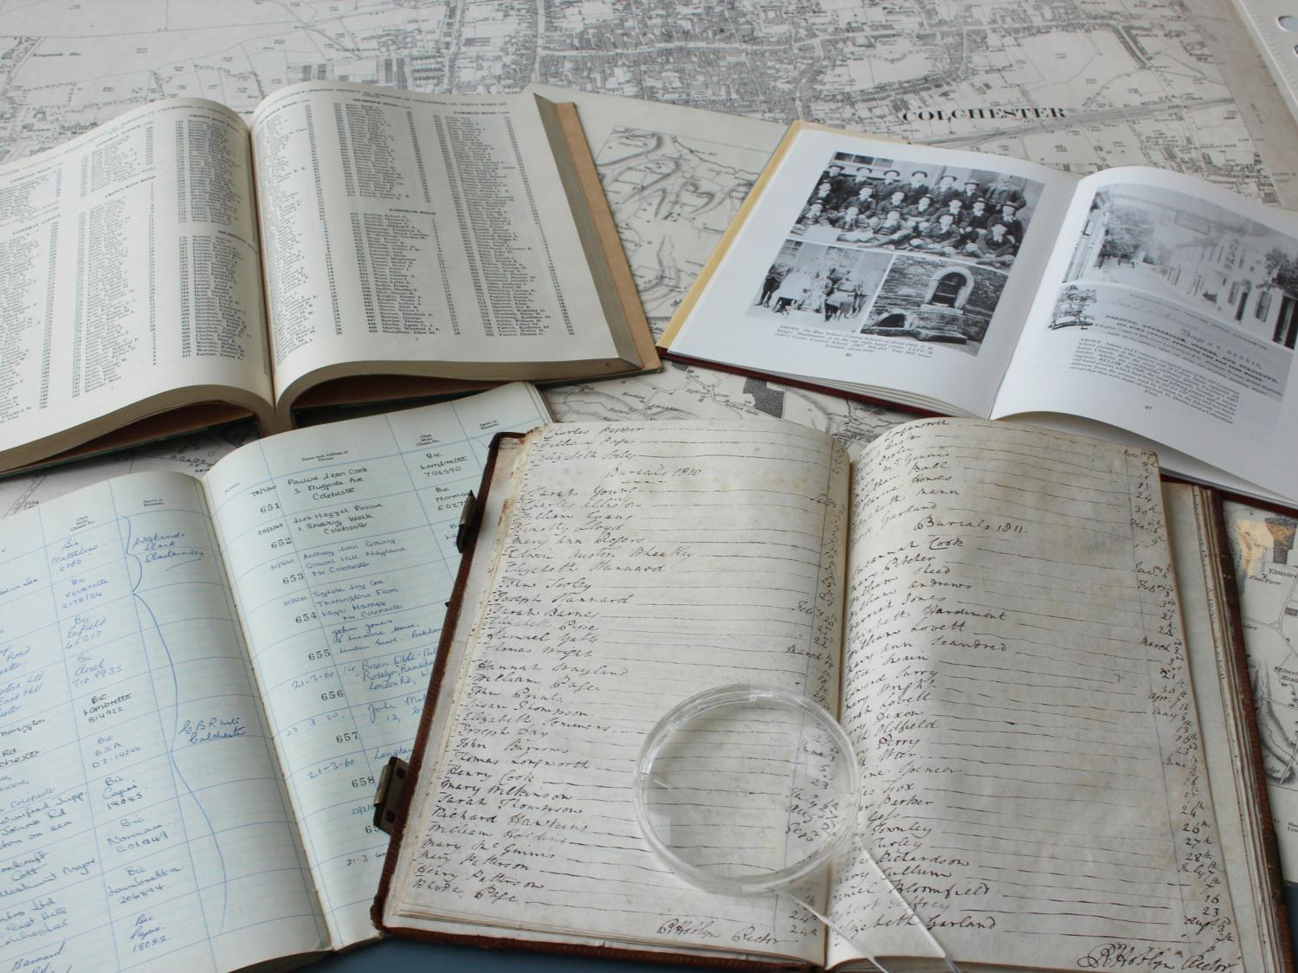
Letters
Diaries
Newspapers
Maps
Photographs

Slide 6
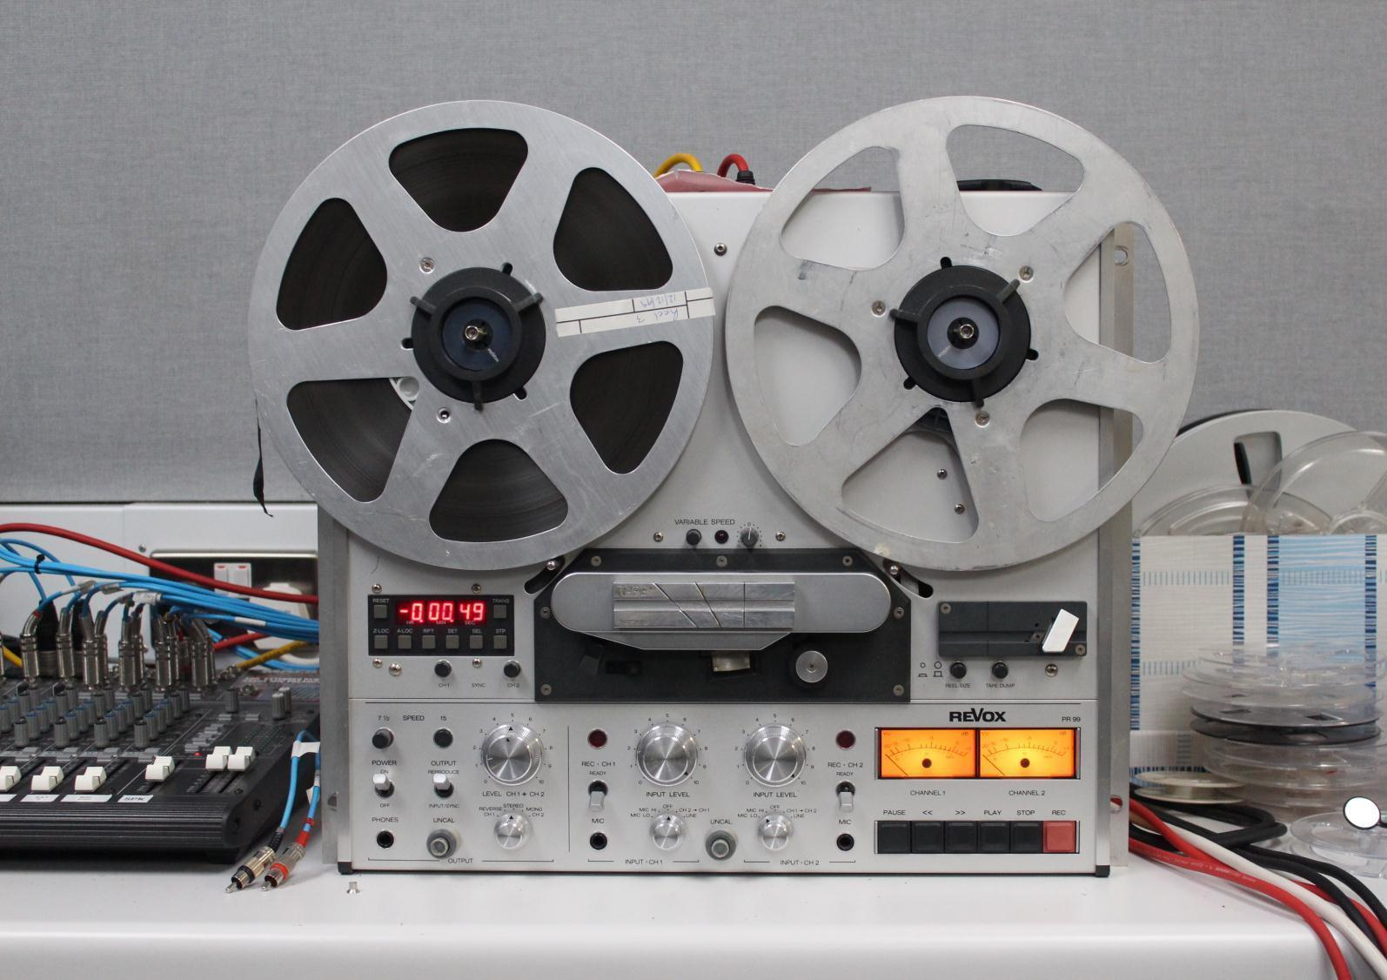
30,000 sound and video recordings

Slide 7
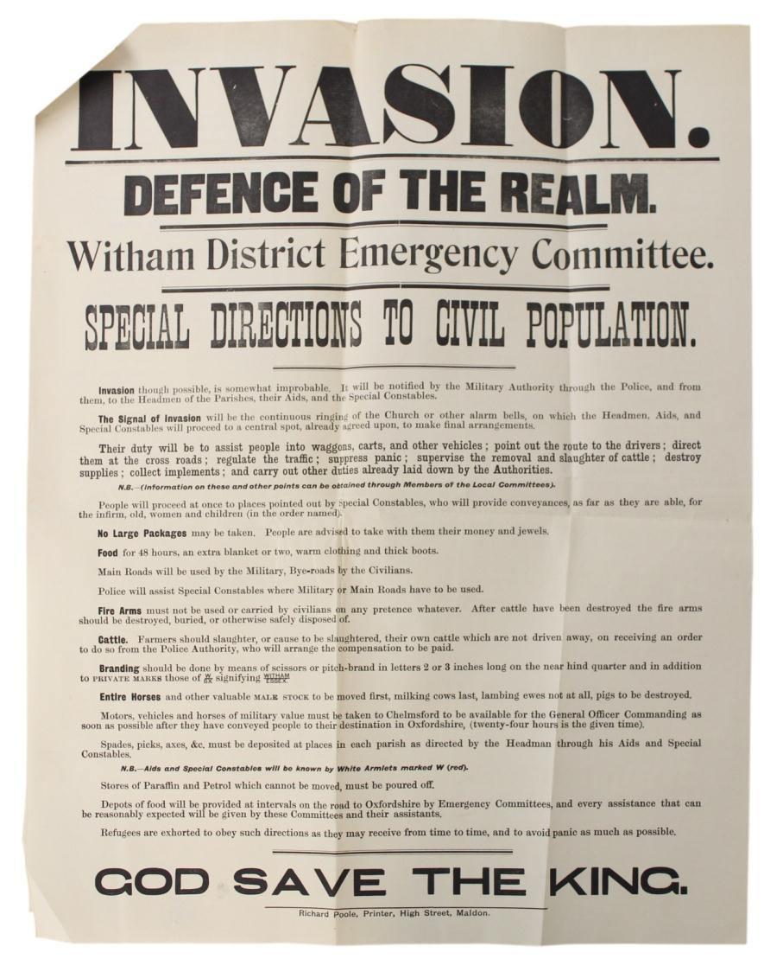
Resource 1: Poster warning of potential German invasion (L/P 3/6)

Slide 8
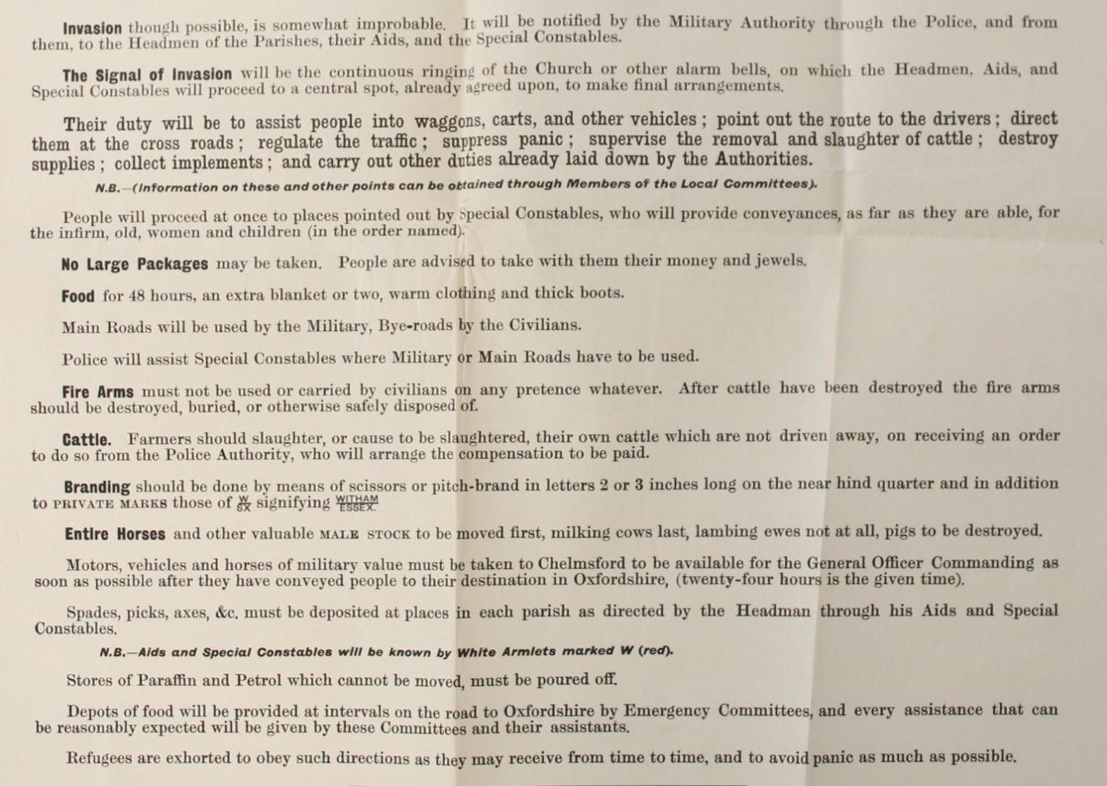
Resource 1: Poster warning of potential German invasion (L/P 3/6)

Slide 9
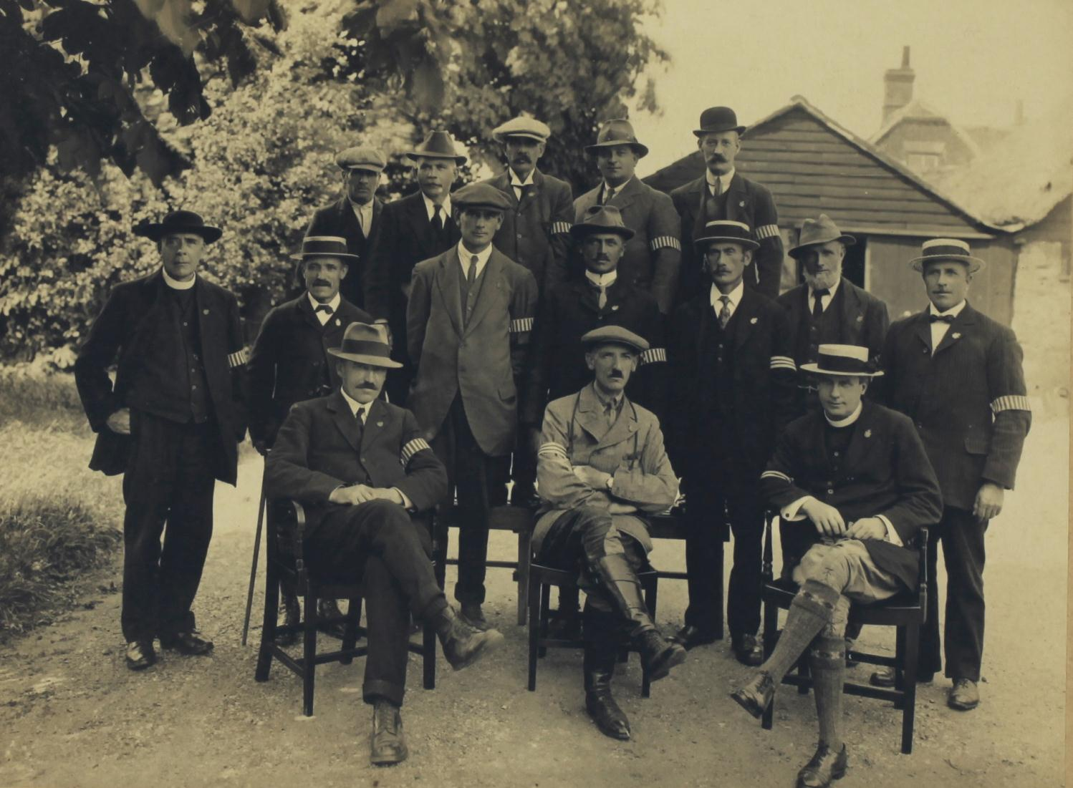
Resource 2: Photograph of Special Constables (D/DU 1359/4)

Slide 10
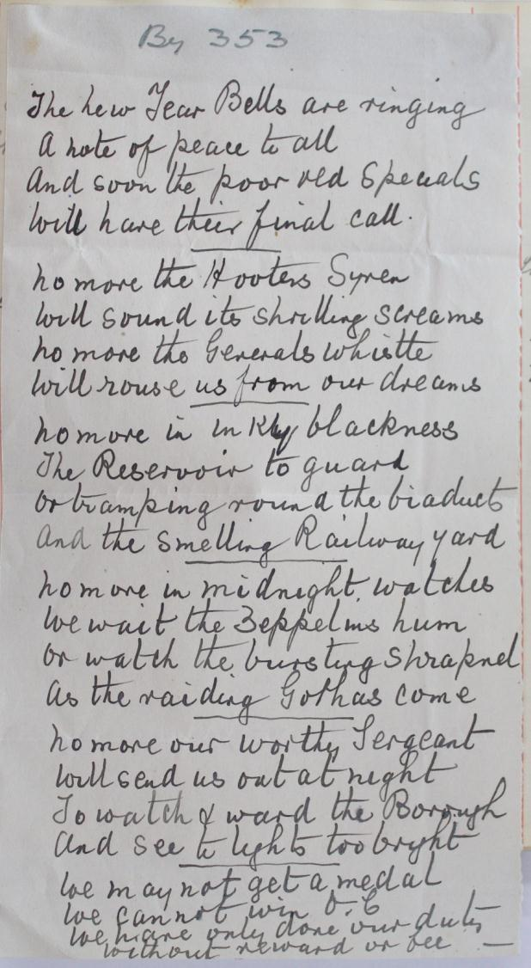
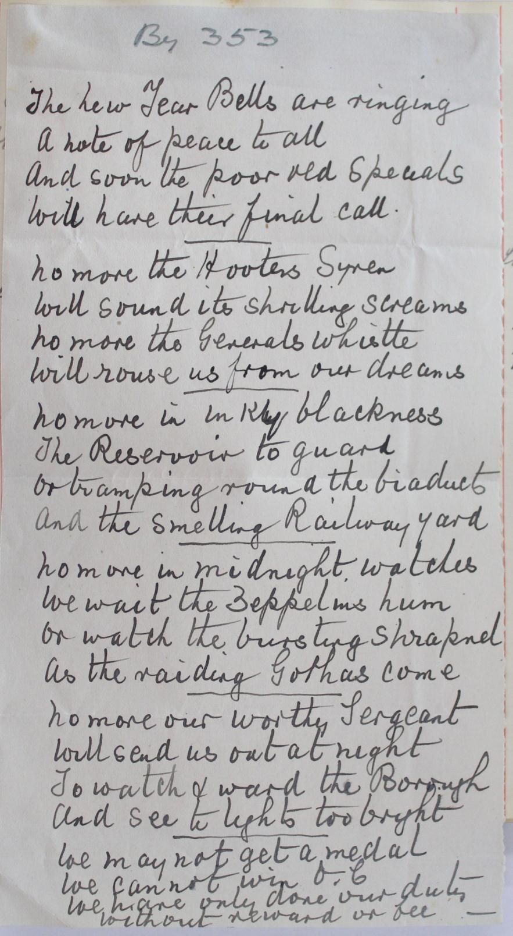
Resource 3: Poem by Special Constable 353) (D/Z 137/1)

Slide 11
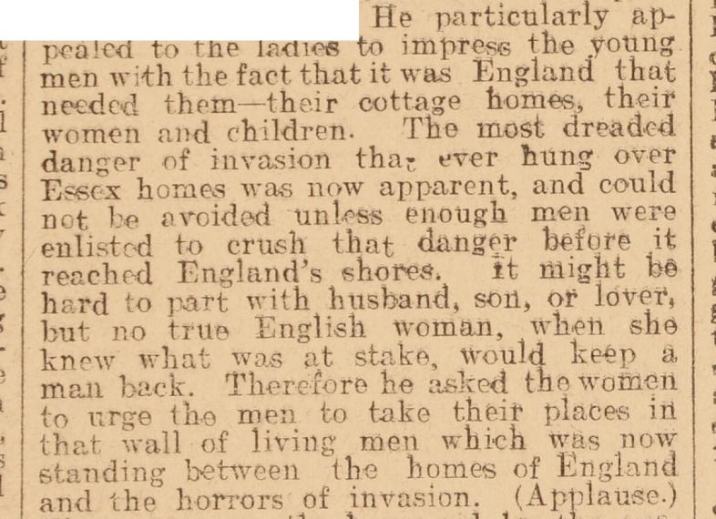
Resource 4a: Percy Laurence, J.P, speaking at a recruitment meeting in Witham, reported in the Chelmsford Chronicle on Friday 13 November 1914

Slide 12
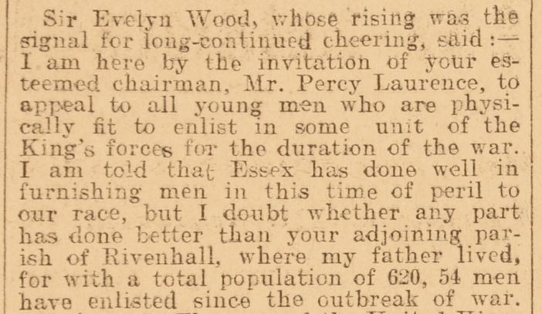
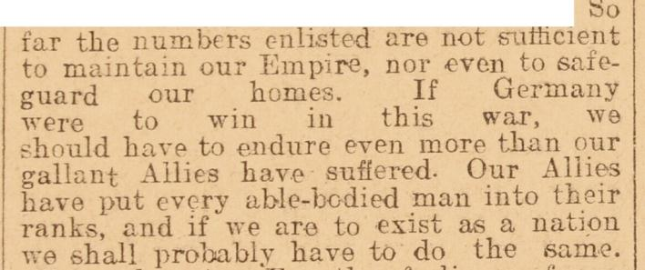
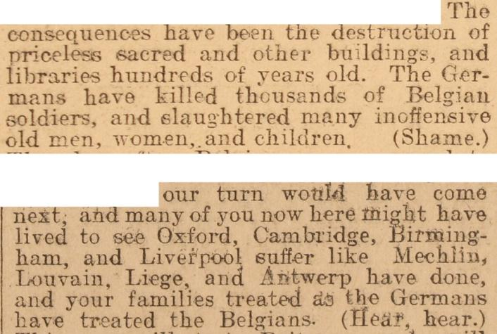
Resource 4b: Field Marshal Sir Evelyn Wood, V.C. speaking at a recruitment meeting in Witham, reported in the Chelmsford Chronicle 13 November 1914

Slide 13
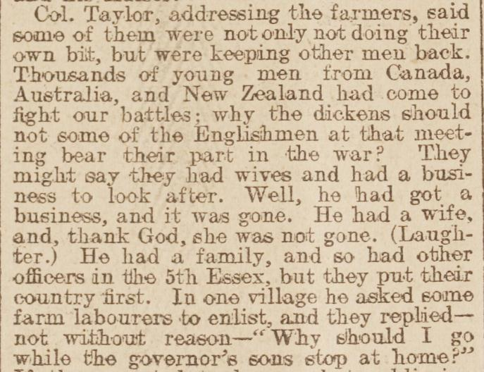
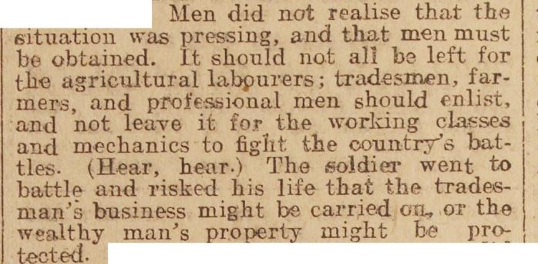
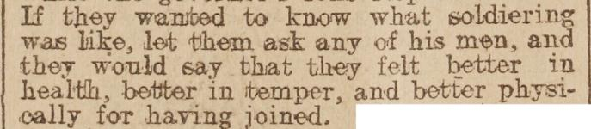
Resource 4c: Lt-Col Fred Taylor speaking at a recruitment meeting in Witham, reported in the Chelmsford Chronicle 13 November 1914
Resource 4d: Lt-Col Fred Taylor speaking at a recruitment meeting in Colchester, reported in the Chelmsford Chronicle 14 May 1915

Slide 14
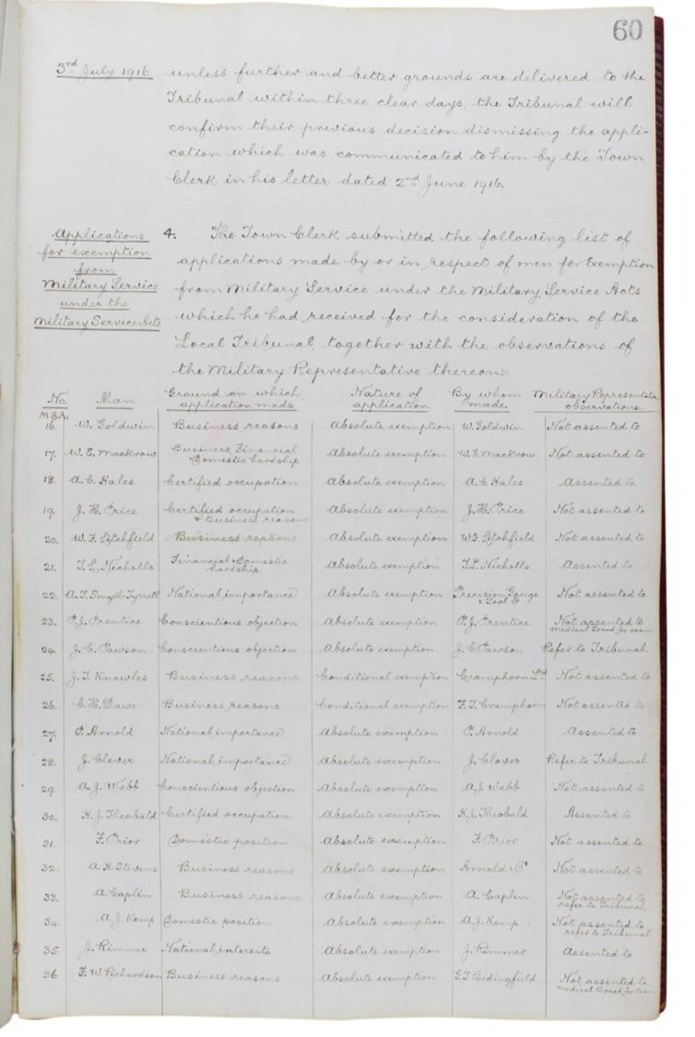
Resource 5: Chelmsford Military Tribunal records (D/B7 M3/2/1)

Slide 15
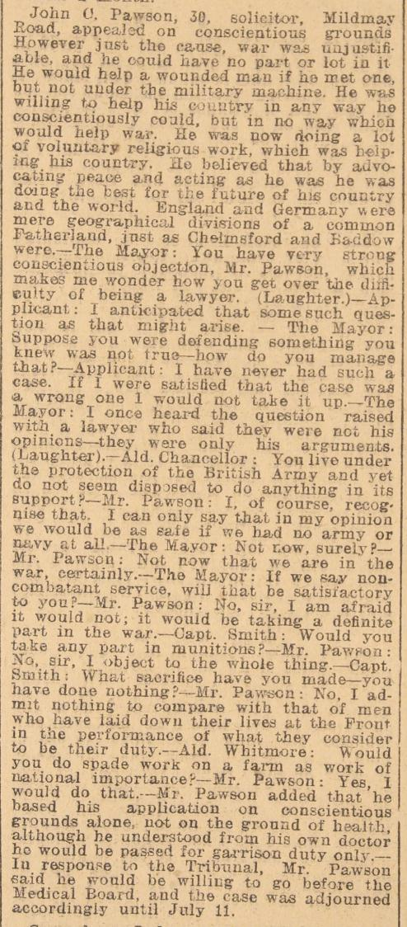
Resource 6: Report on tribunal hearing of John Pawson, Chelmsford Chronicle, 7 July 1916

Slide 16
Recollections of Alf Webb
Listen to the memories of Alf Webb about his time on the Western Front here:
https://soundcloud.com/essex-record-office/i-didnt-want-medals-one-mans
Resource 7: Recollections of Alf Webb (SA 24/1011/1)

Slide 17
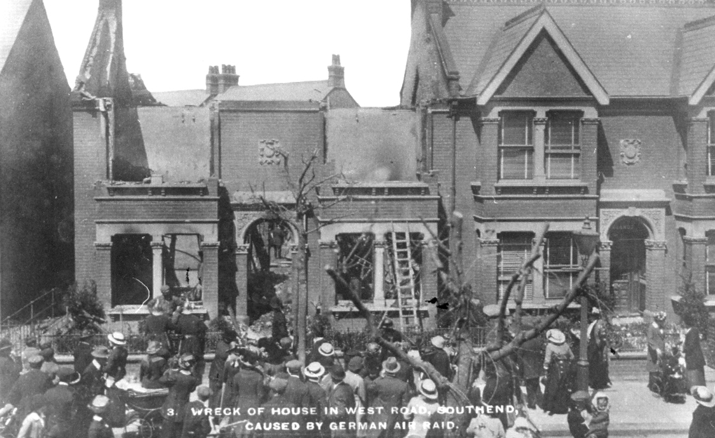
Resource 8: Photograph of bomb damage in Southend, May 1915 (TS 399/3)

Slide 18
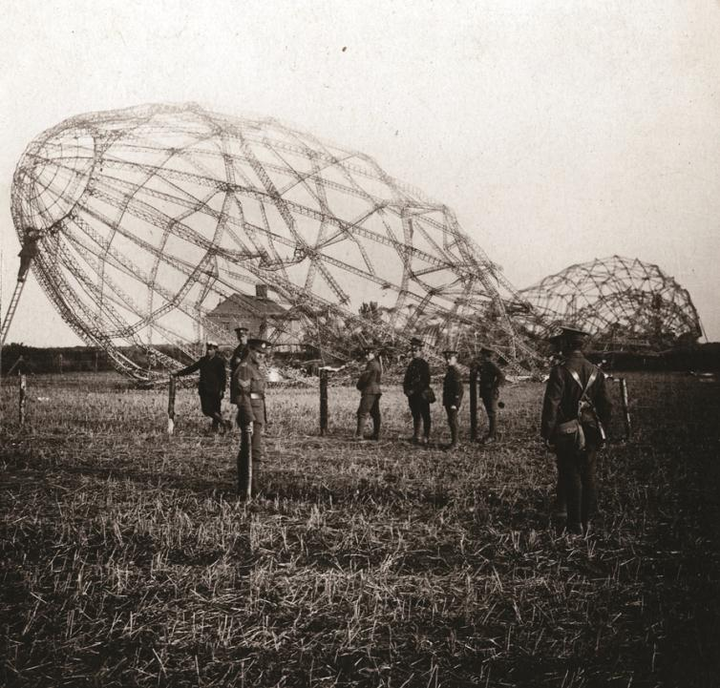
Resource 9a:
Photograph of Zeppelin L33, which crashed in Little Wigborough on 23 September 1916

Slide 19
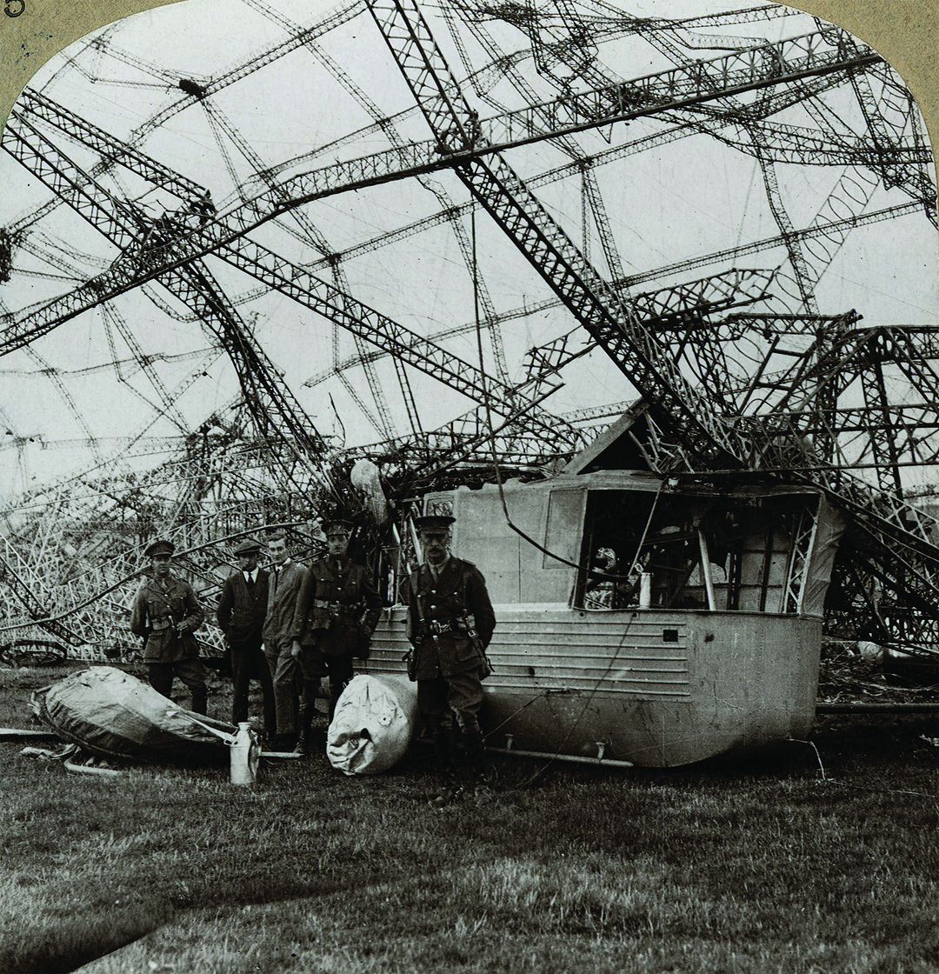
Resource 9b:
Photograph of Zeppelin L33, which crashed in Little Wigborough on 23 September 1916

Slide 20
For slides 20-50, please download part 2 of the PowerPoint presentation here

